Slide 1
CSCI 347 Data Mining
Graph Data

Slide 2
Graph Data
Data instances are often not entirely independent
they can be interconnected through various types of relationships.
Graph data or networks are a data structure where instances are depicted as nodes, and the connections between these instances are represented by edges.

Slide 3
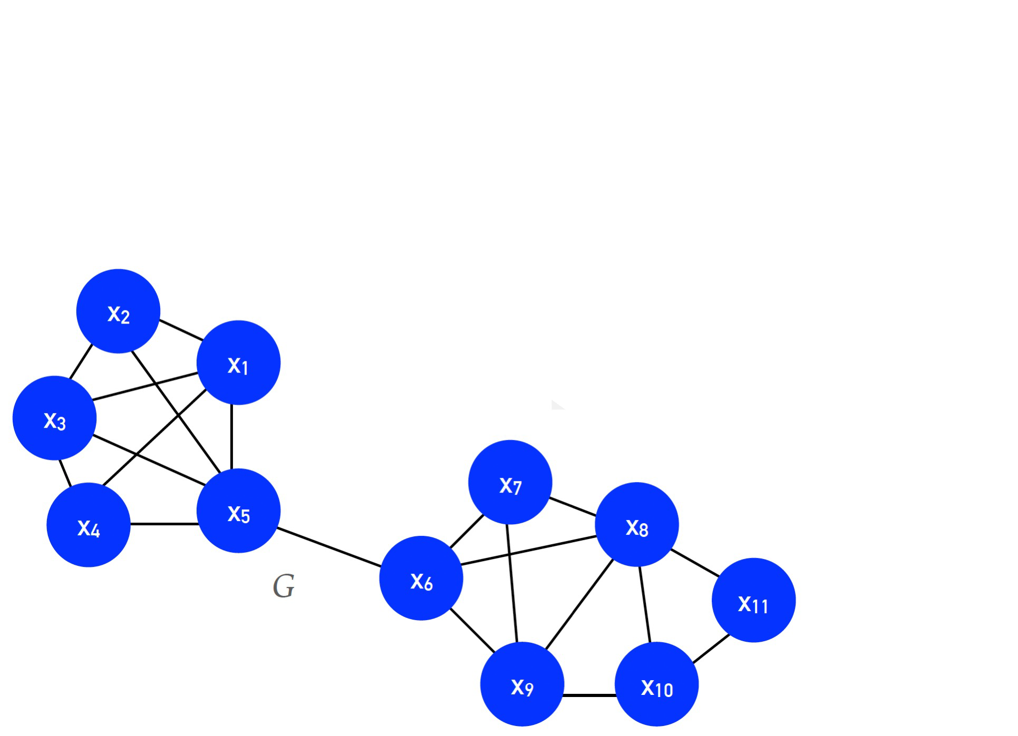

Graph Data
$$G=\left(V, E\right)$$
$$V=set of vertices$$
$$E⊆V×V, is the set of vertices in the graph$$

Slide 4
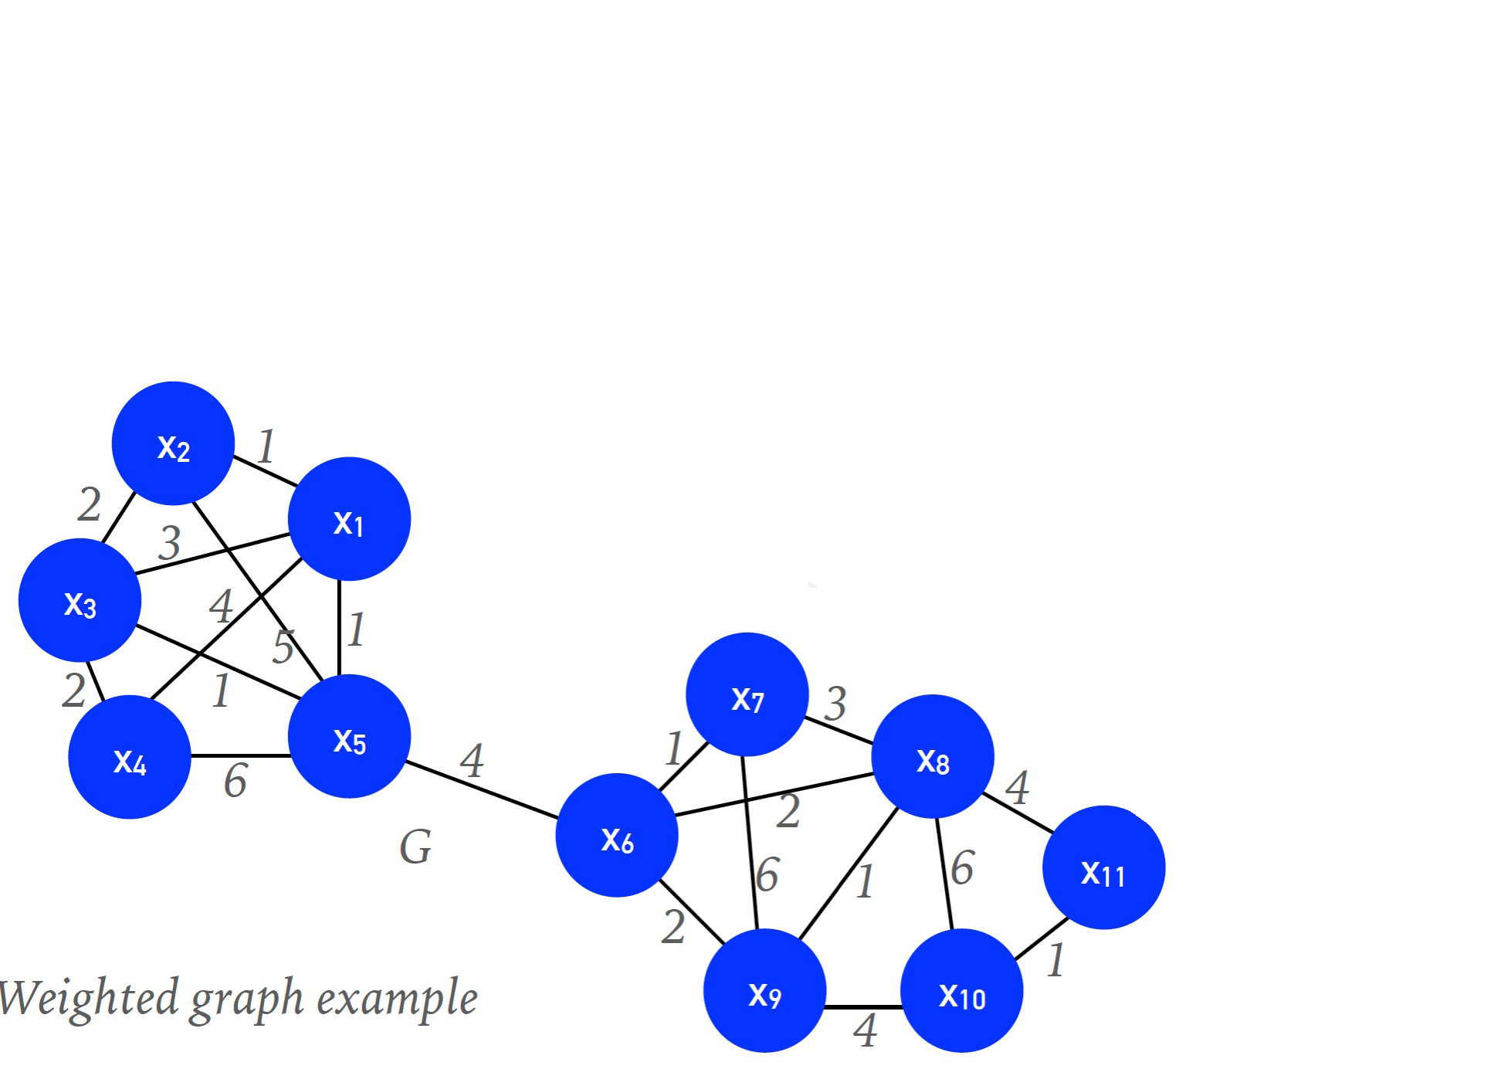
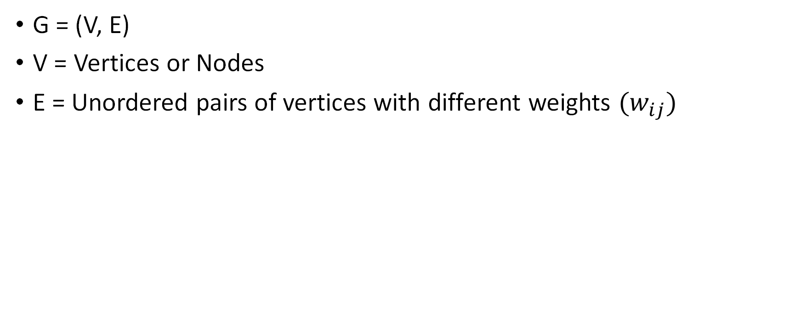
Graph Data (Weighted graph)
G = (V, E)
V = Vertices or Nodes
E = Unordered pairs of vertices with different weights $(w_{ij})$

Slide 5
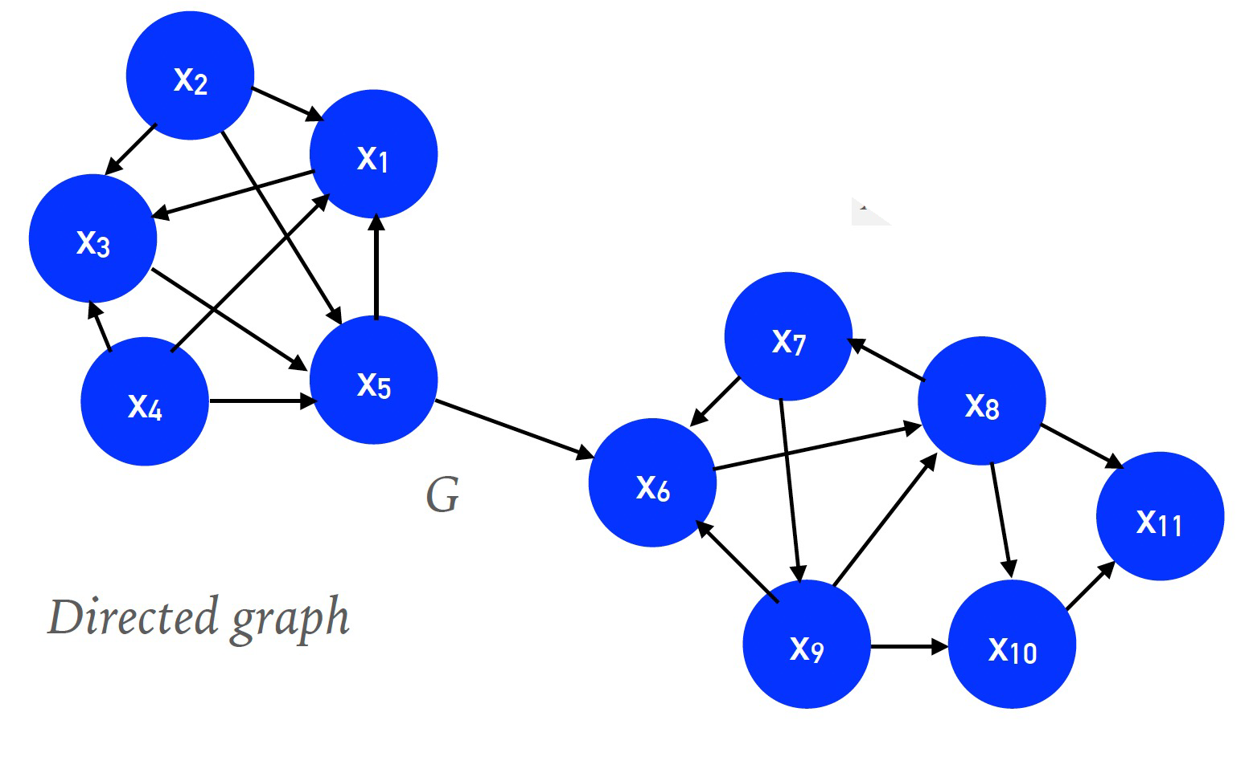
Graph Data (Directed Graph)
G = (V, E)
V = Vertices or Nodes
E = ordered pairs of vertices.

Slide 6
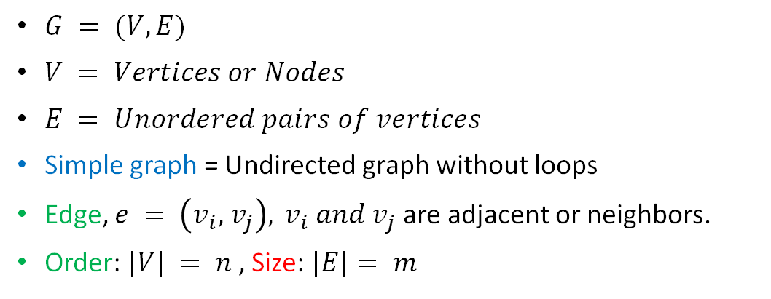
Graph Data
$G = (V, E)$
$V = Vertices or Nodes$
$E = Unordered pairs of vertices$
Simple graph = Undirected graph without loops
Edge, $e = \left(v_{i}, { v}_{j}\right),{ v}_{i} and v_{j}$ are adjacent or neighbors.
Order: $|V| = n$, Size: $|E|= m$

Slide 7
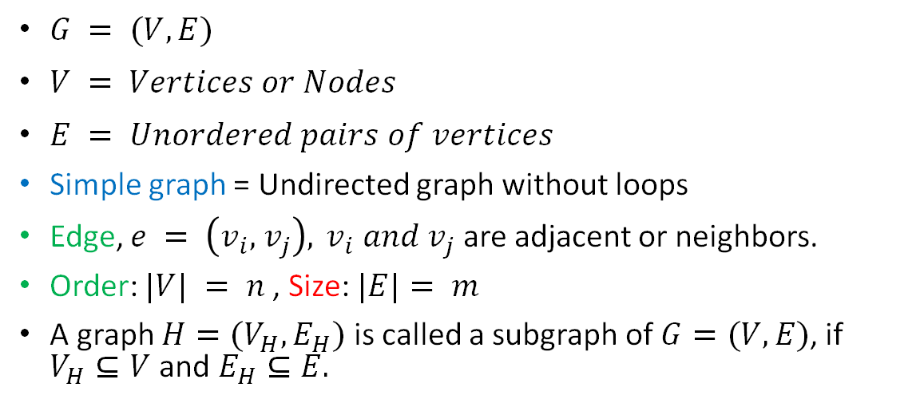
Graph Data
$G = (V, E)$
$V = Vertices or Nodes$
$E = Unordered pairs of vertices$
Simple graph = Undirected graph without loops
Edge, $e = \left(v_{i}, { v}_{j}\right),{ v}_{i} and v_{j}$ are adjacent or neighbors.
Order: $|V| = n$, Size: $|E|= m$
A graph $H=(V_{H}, E_{H})$ is called a subgraph of $G=(V, E)$, if $V_{H}⊆V$ and $E_{H}⊆E.$

Slide 8
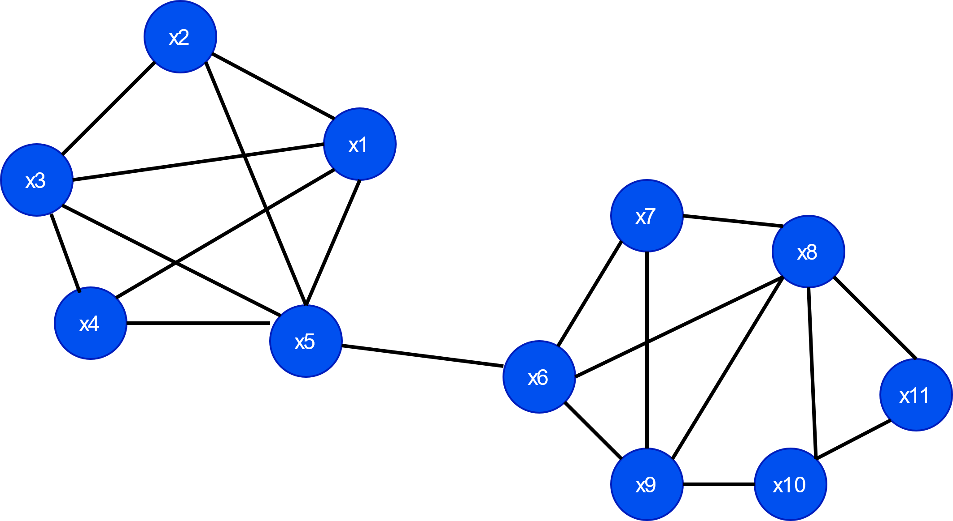
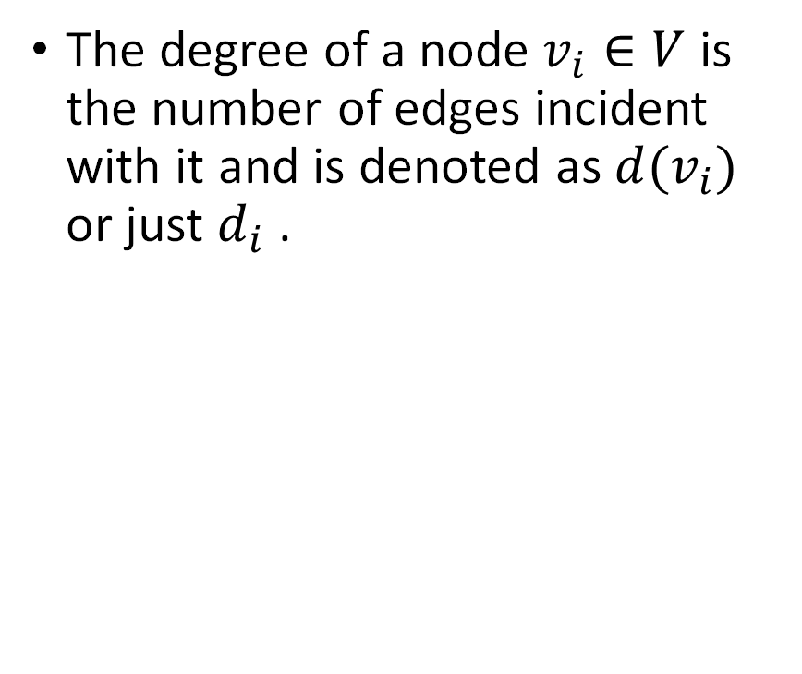
Degree of a node
The degree of a node $v_{i}∈V$is the number of edges incident with it and is denoted as $d(v_{i})$ or just $d_{i}$ .

Slide 9
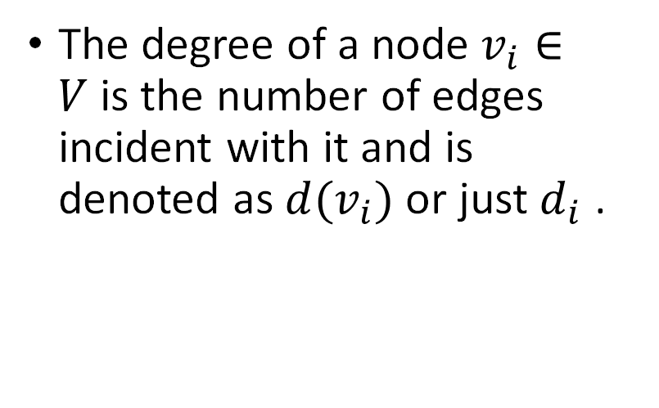
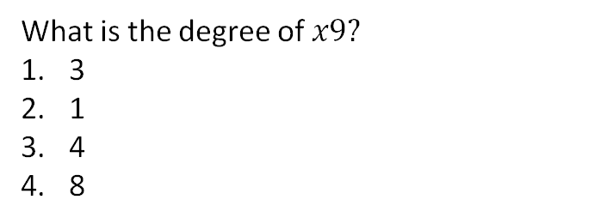
Degree of a node
The degree of a node $v_{i}∈V$is the number of edges incident with it and is denoted as $d(v_{i})$ or just $d_{i}$ .
What is the degree of $x9?$
3
1
4
8

Slide 10
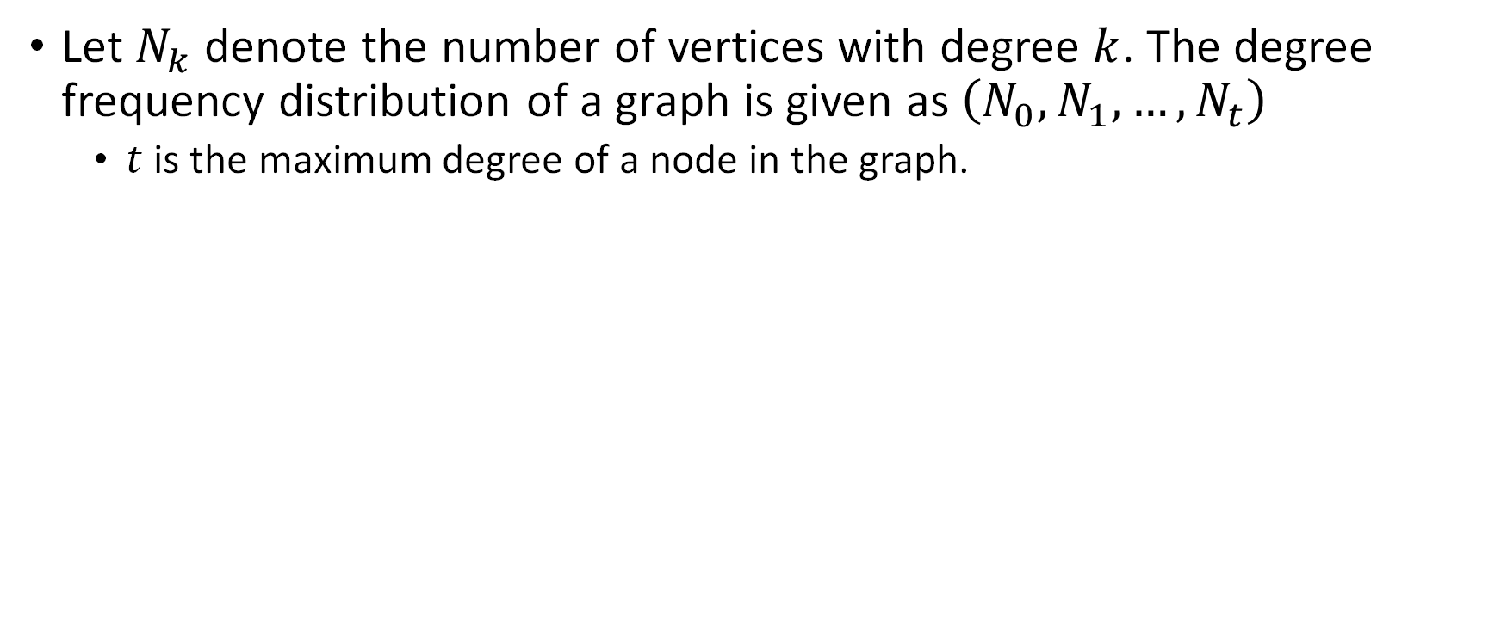
Degree Distribution
Let $N_{k}$ denote the number of vertices with degree $k$. The degree frequency distribution of a graph is given as $\left(N_{0},N_{1},…, N_{t}\right)$
$t$ is the maximum degree of a node in the graph.

Slide 11
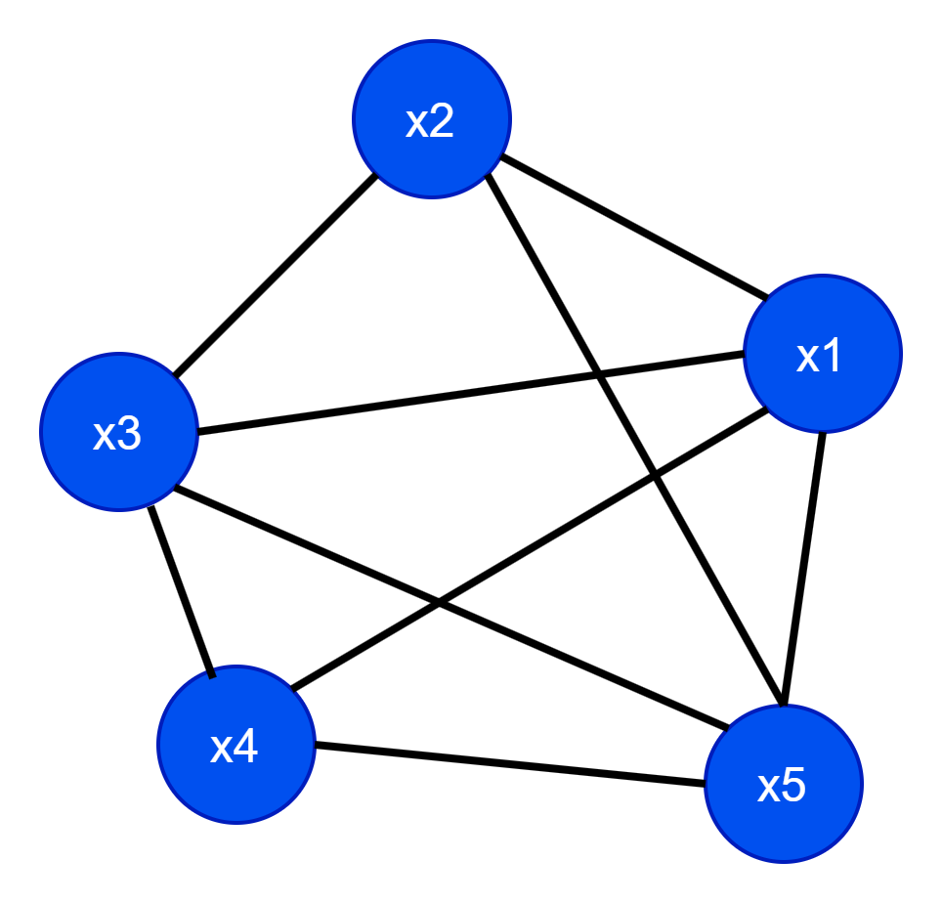
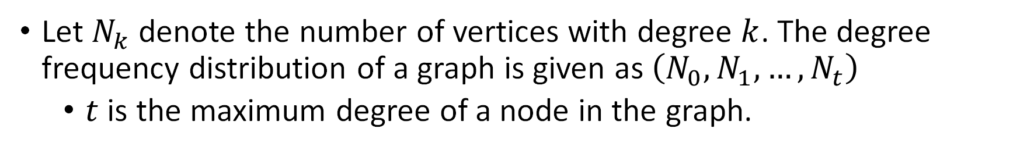
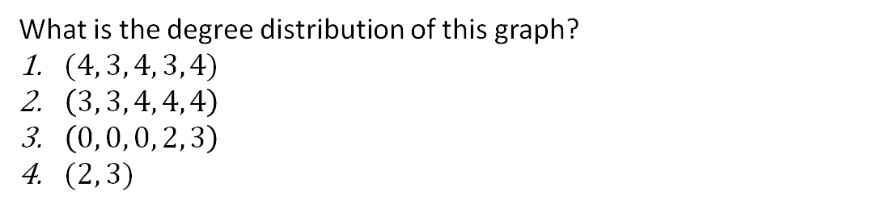
Degree Distribution
Let $N_{k}$ denote the number of vertices with degree $k$. The degree frequency distribution of a graph is given as $\left(N_{0},N_{1},…, N_{t}\right)$
$t$ is the maximum degree of a node in the graph.
What is the degree distribution of this graph?
$(4, 3, 4, 3, 4)$
$\left(3, 3, 4, 4, 4\right)$
$\left(0, 0, 0, 2, 3\right)$
$(2, 3)$

Slide 12
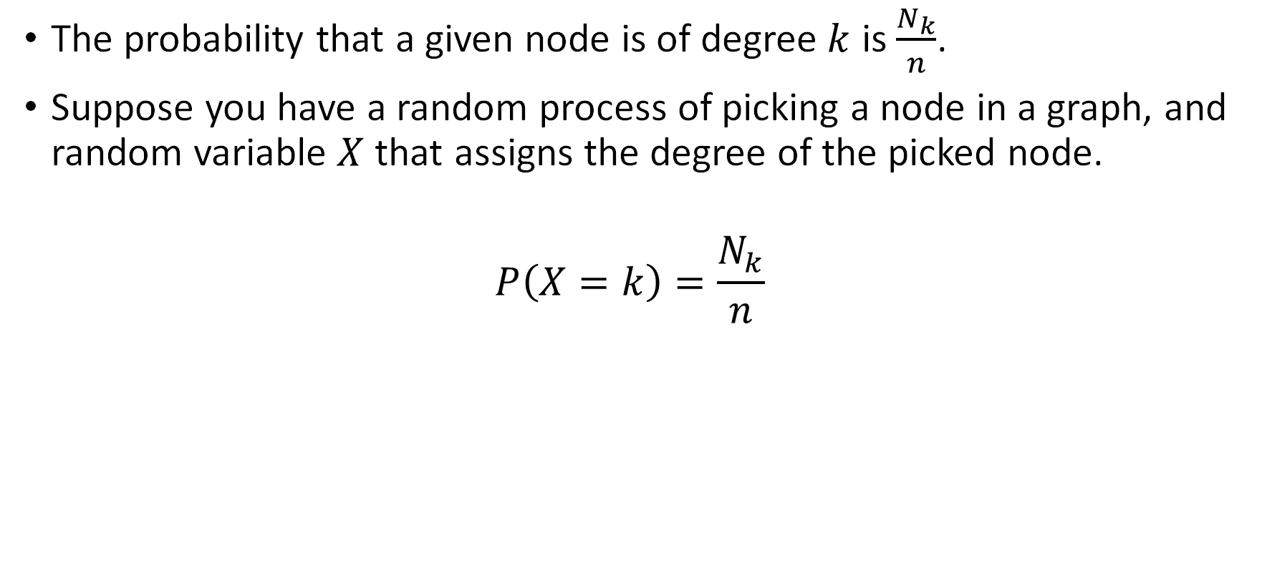
Degree Distribution
The probability that a given node is of degree $k$ is $\frac{N_{k}}{n}$.
Suppose you have a random process of picking a node in a graph, and random variable $X$ that assigns the degree of the picked node.
$$P\left(X=k\right)=\frac{N_{k}}{n}$$

Slide 13
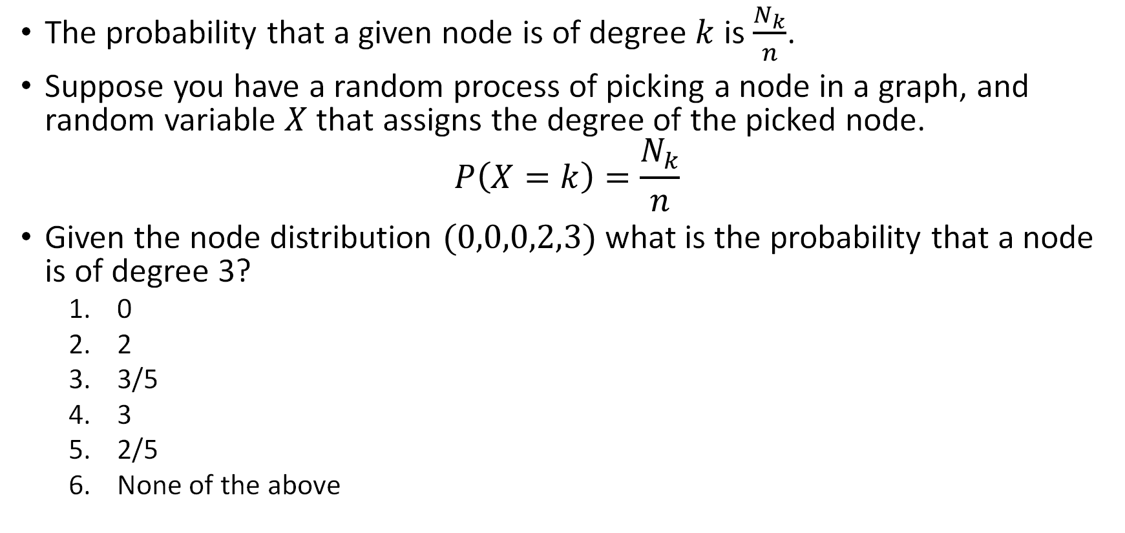
Degree Distribution
The probability that a given node is of degree $k$ is $\frac{N_{k}}{n}$.
Suppose you have a random process of picking a node in a graph, and random variable $X$ that assigns the degree of the picked node.
$$P\left(X=k\right)=\frac{N_{k}}{n}$$
Given the node distribution $(0,0,0,2,3)$ what is the probability that a node is of degree 3?
0
2
3/5
3
2/5
None of the above

Slide 14
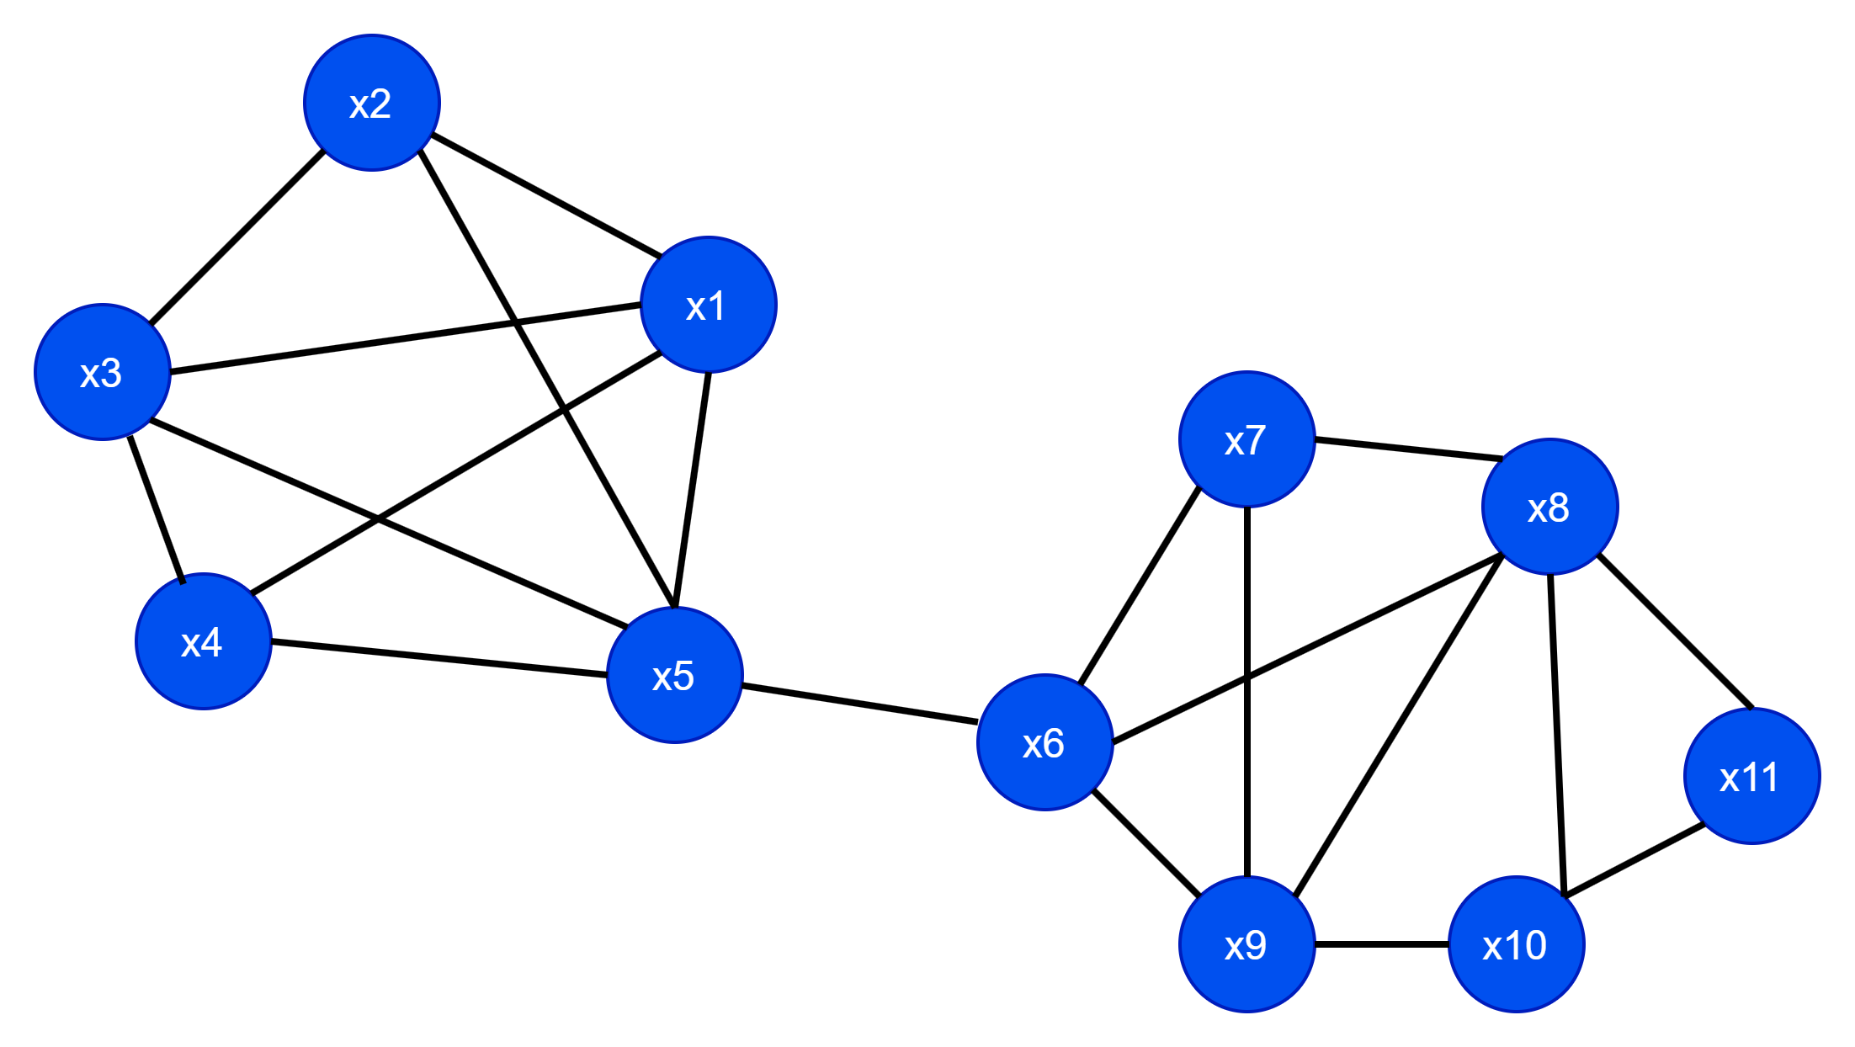
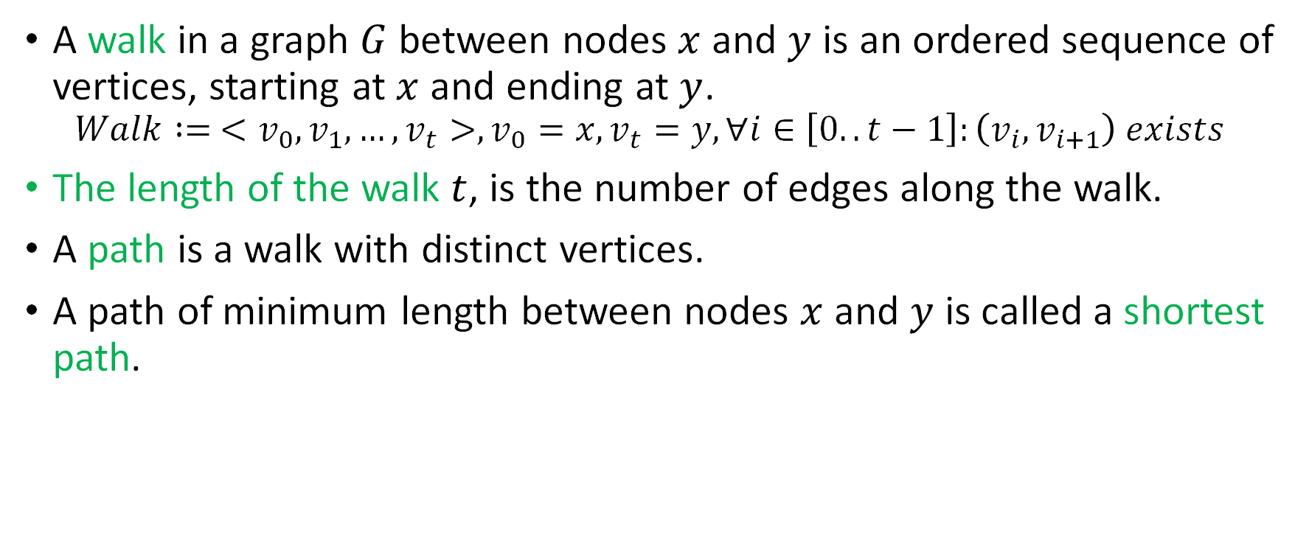
Walk, Path, shortest path
A walk in a graph $G$ between nodes $x$ and $y$ is an ordered sequence of vertices, starting at $x$ and ending at $y$.
$$Walk := <v_{0},v_{1},…,v_{t}>,v_{0}=x, v_{t}=y, ∀i∈\left[0..t−1\right]:\left(v_{i},v_{i+1}\right) exists$$
The length of the walk $t$, is the number of edges along the walk.
A path is a walk with distinct vertices.
A path of minimum length between nodes $x$ and $y$ is called a shortest path.

Slide 15
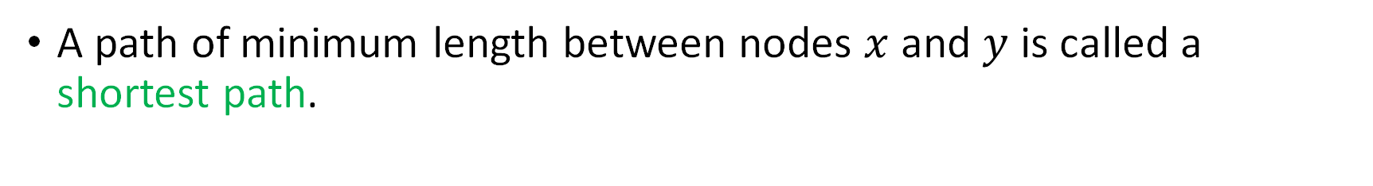
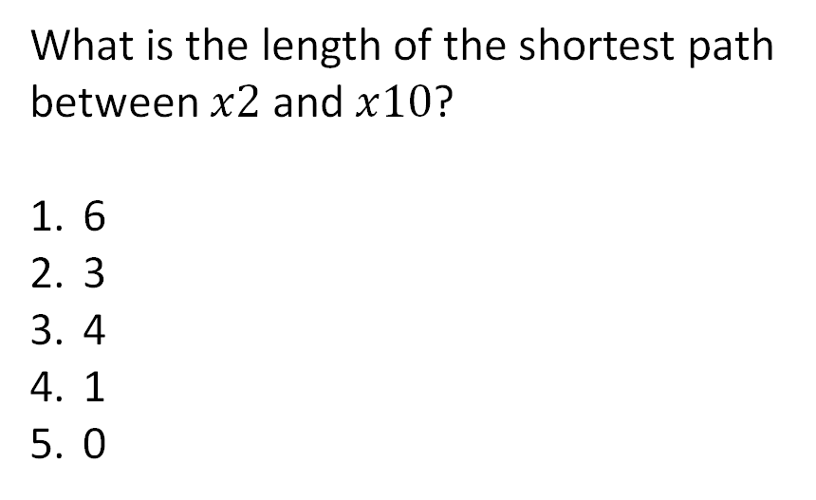
Walk, Path, shortest path
A path of minimum length between nodes $x$ and $y$ is called a shortest path.
What is the length of the shortest path between $x2$ and $x10$?
6
3
4
1
0

Slide 16
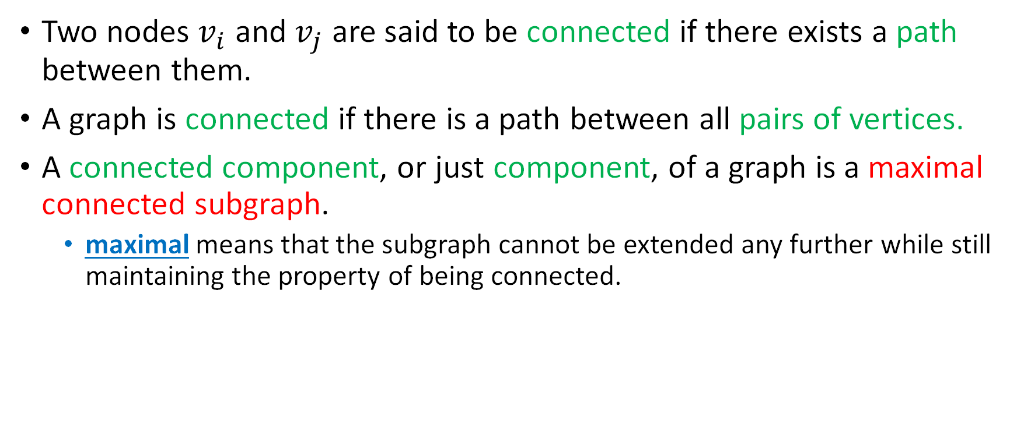
Connectedness
Two nodes $v_{i}$ and $v_{j}$ are said to be connected if there exists a path between them.
A graph is connected if there is a path between all pairs of vertices.
A connected component, or just component, of a graph is a maximal connected subgraph.
maximal means that the subgraph cannot be extended any further while still maintaining the property of being connected.

Slide 17
Connectedness
Is this graph connected?
Yes
No

Slide 18
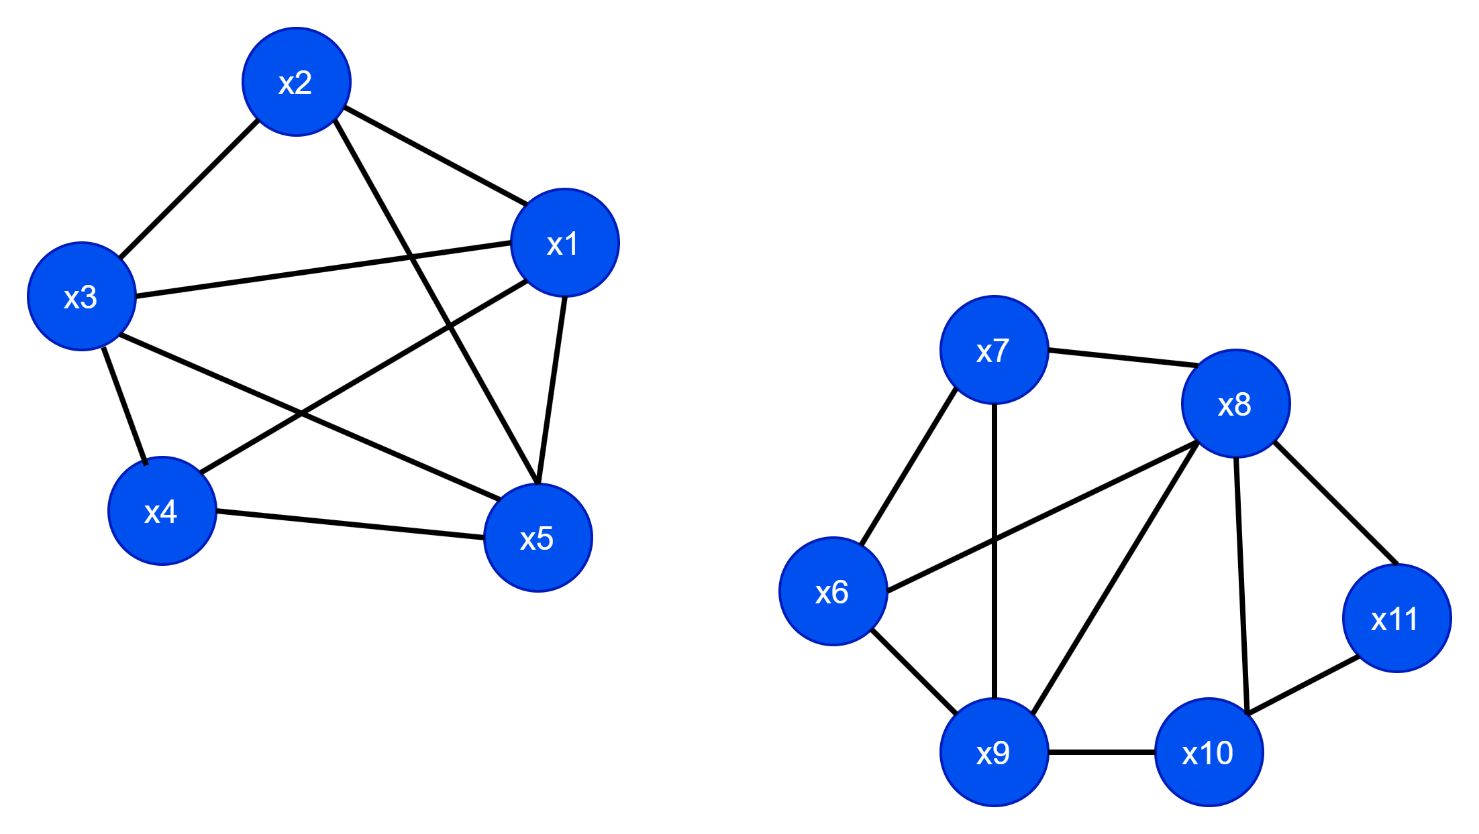
Connectedness
Is this graph connected?
Yes
No

Slide 19
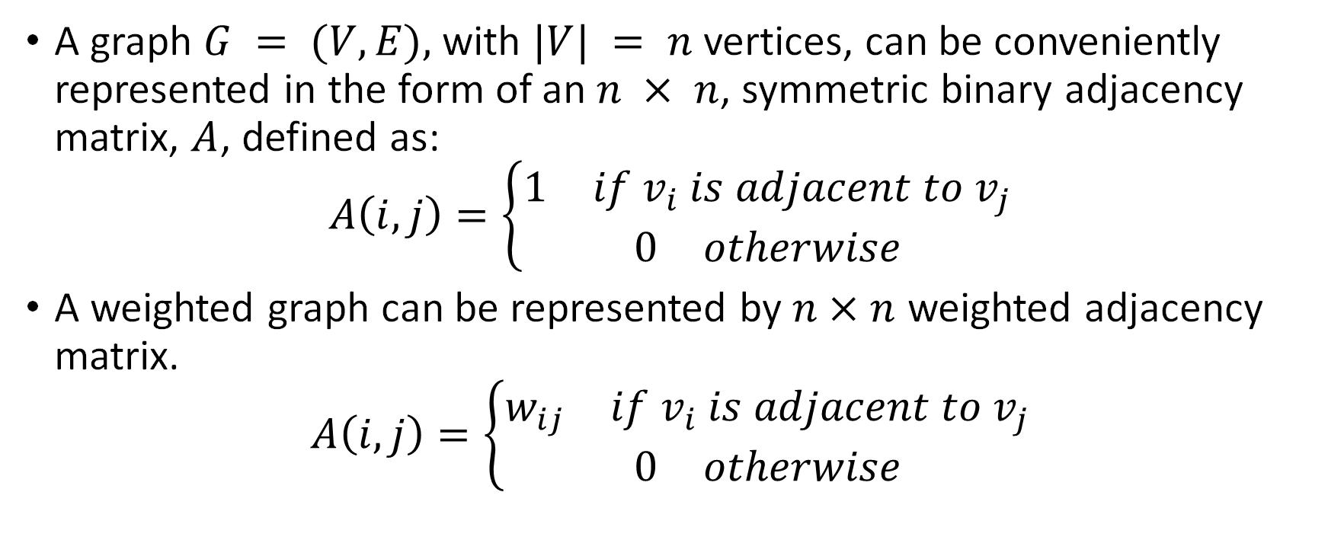
Adjacency Matrix
A graph $G = (V,E),$with $|V| = n$ vertices, can be conveniently represented in the form of an $n × n$, symmetric binary adjacency matrix, $A$, defined as:
$$A\left(i,j\right)=\left\{\begin{aligned}\begin{matrix}1 & if v_{i} is adjacent to v_{j}\end{matrix} \\ \begin{matrix}0 & otherwise\end{matrix}\end{aligned}\right.$$
A weighted graph can be represented by $n×n$ weighted adjacency matrix.
$$A\left(i,j\right)=\left\{\begin{aligned}\begin{matrix}w_{ij} & if v_{i} is adjacent to v_{j}\end{matrix} \\ \begin{matrix}0 & otherwise\end{matrix}\end{aligned}\right.$$

Slide 20

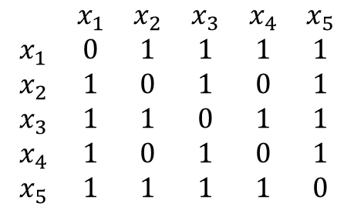
Adjacency matrix example.
$$\begin{matrix} & x_{1} & x_{2} & x_{3} & x_{4} & x_{5} \\ x_{1} & 0 & 1 & 1 & 1 & 1 \\ x_{2} & 1 & 0 & 1 & 0 & 1 \\ x_{3} & 1 & 1 & 0 & 1 & 1 \\ x_{4} & 1 & 0 & 1 & 0 & 1 \\ x_{5} & 1 & 1 & 1 & 1 & 0\end{matrix}$$

Slide 21
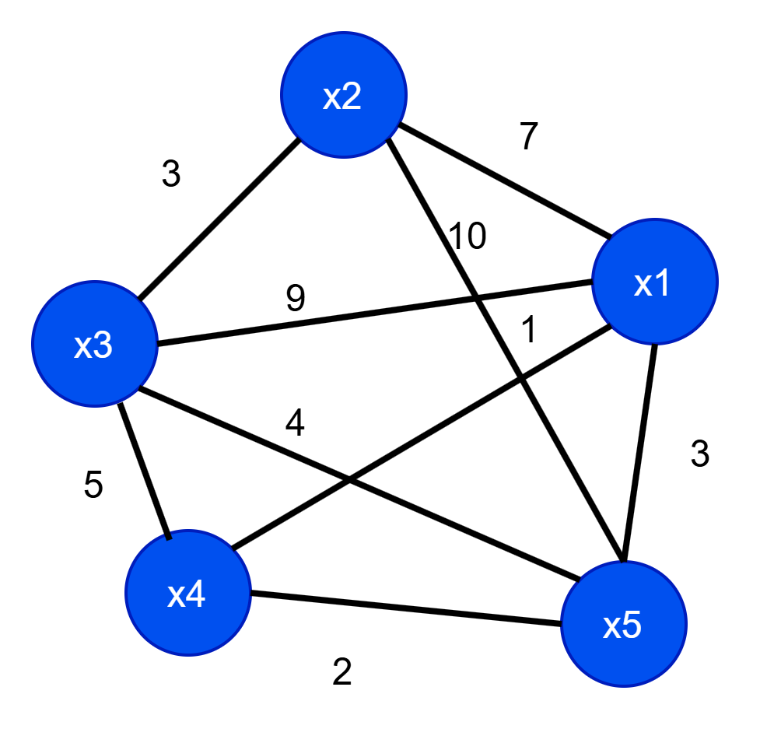
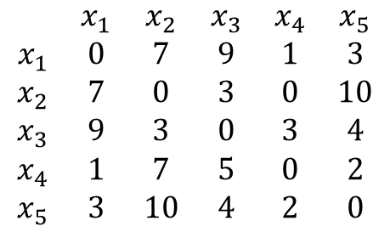
Adjacency matrix (weighted) example.
$$\begin{matrix} & x_{1} & x_{2} & x_{3} & x_{4} & x_{5} \\ x_{1} & 0 & 7 & 9 & 1 & 3 \\ x_{2} & 7 & 0 & 3 & 0 & 10 \\ x_{3} & 9 & 3 & 0 & 3 & 4 \\ x_{4} & 1 & 7 & 5 & 0 & 2 \\ x_{5} & 3 & 10 & 4 & 2 & 0\end{matrix}$$

Slide 22
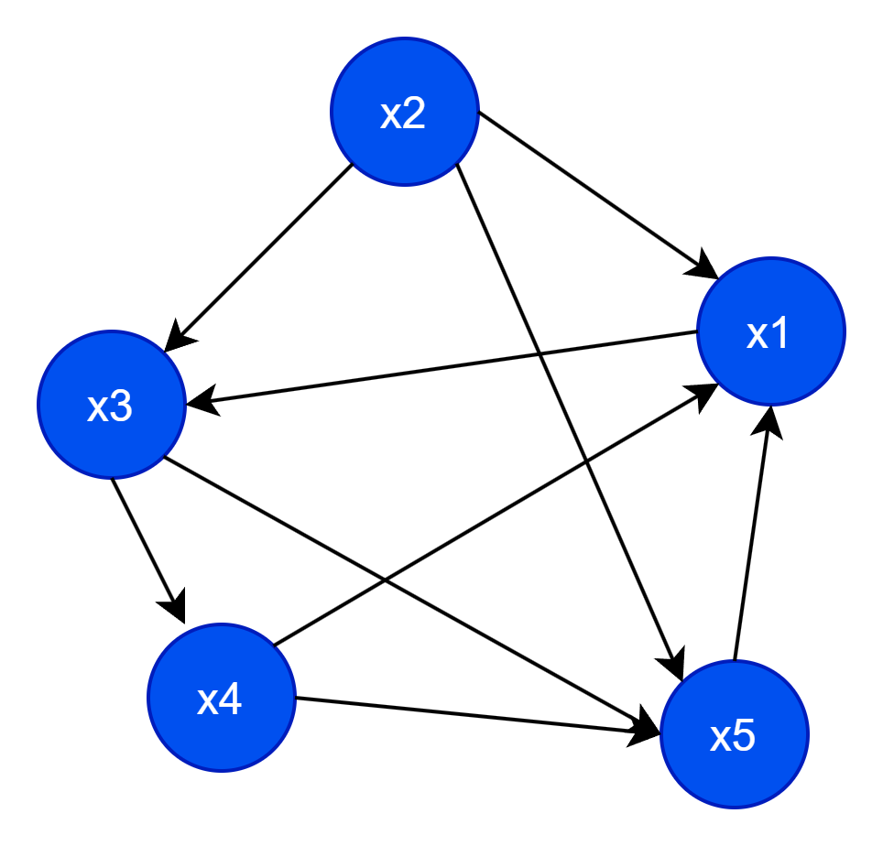
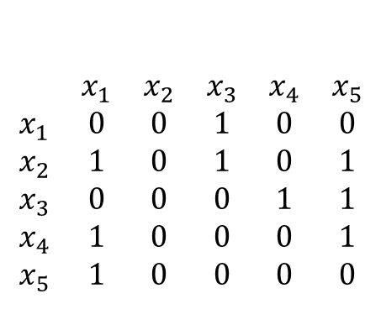
Adjacency matrix: directed graph
In a directed graph adjacency matrix is not symmetric.
$$\begin{matrix} & x_{1} & x_{2} & x_{3} & x_{4} & x_{5} \\ x_{1} & 0 & 0 & 1 & 0 & 0 \\ x_{2} & 1 & 0 & 1 & 0 & 1 \\ x_{3} & 0 & 0 & 0 & 1 & 1 \\ x_{4} & 1 & 0 & 0 & 0 & 1 \\ x_{5} & 1 & 0 & 0 & 0 & 0\end{matrix}$$

Slide 23

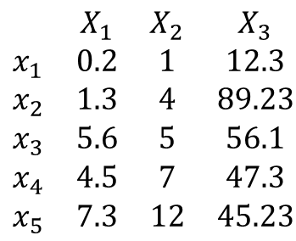

Graphs from Data Matrix
Given a dataset in the form of a matrix, can we create a graph?
$$\begin{matrix} & X_{1} & X_{2} & X_{3} \\ x_{1} & 0.2 & 1 & 12.3 \\ x_{2} & 1.3 & 4 & 89.23 \\ x_{3} & 5.6 & 5 & 56.1 \\ x_{4} & 4.5 & 7 & 47.3 \\ x_{5} & 7.3 & 12 & 45.23\end{matrix}$$
$$?$$
But what can we do about the edges?

Slide 24
Graphs from Data Matrix
Given a dataset in the form of a matrix, can we create a graph?
$$\begin{matrix} & X_{1} & X_{2} & X_{3} \\ x_{1} & 0.2 & 1 & 12.3 \\ x_{2} & 1.3 & 4 & 89.23 \\ x_{3} & 5.6 & 5 & 56.1 \\ x_{4} & 4.5 & 7 & 47.3 \\ x_{5} & 7.3 & 12 & 45.23\end{matrix}$$
$$?$$
How about we using a similarity measure and then use the similarity measure as the edge weights?

Slide 25
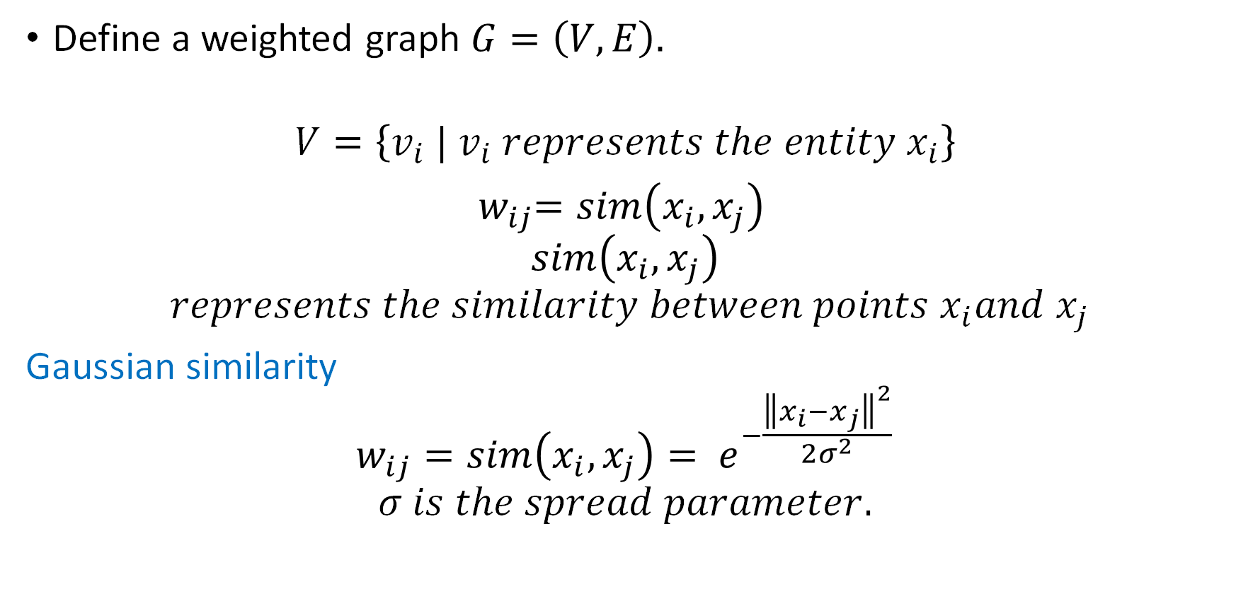
How to create a graph from matrix?
Define a weighted graph $G=\left(V,E\right).$
$$V=\left\{v_{i} | v_{i} represents the entity x_{i}\right\}$$
${ w}_{ij}=sim\left(x_{i}, x_{j}\right)$
$$sim\left(x_{i}, x_{j}\right)$$
$$represents the similarity between points x_{i}and x_{j}$$
Gaussian similarity
$$w_{ij}=sim\left(x_{i}, x_{j}\right)= e^{−\frac{{\left\|x_{i}−x_{j}\right\|}^{2}}{2σ^{2}}}$$
$$σ is the spread parameter.$$

Slide 26
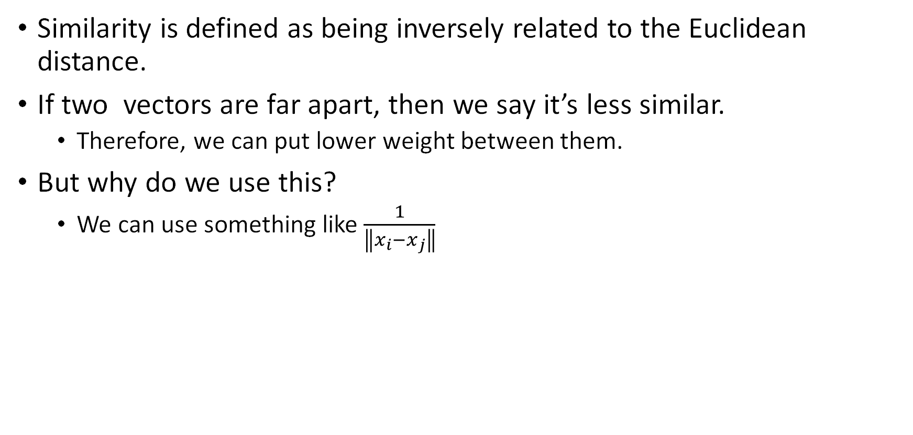
Gaussian similarity
Similarity is defined as being inversely related to the Euclidean distance.
If two vectors are far apart, then we say it’s less similar.
Therefore, we can put lower weight between them.
But why do we use this?
We can use something like $\frac{1}{\left\|x_{i}−x_{j}\right\|}$

Slide 27
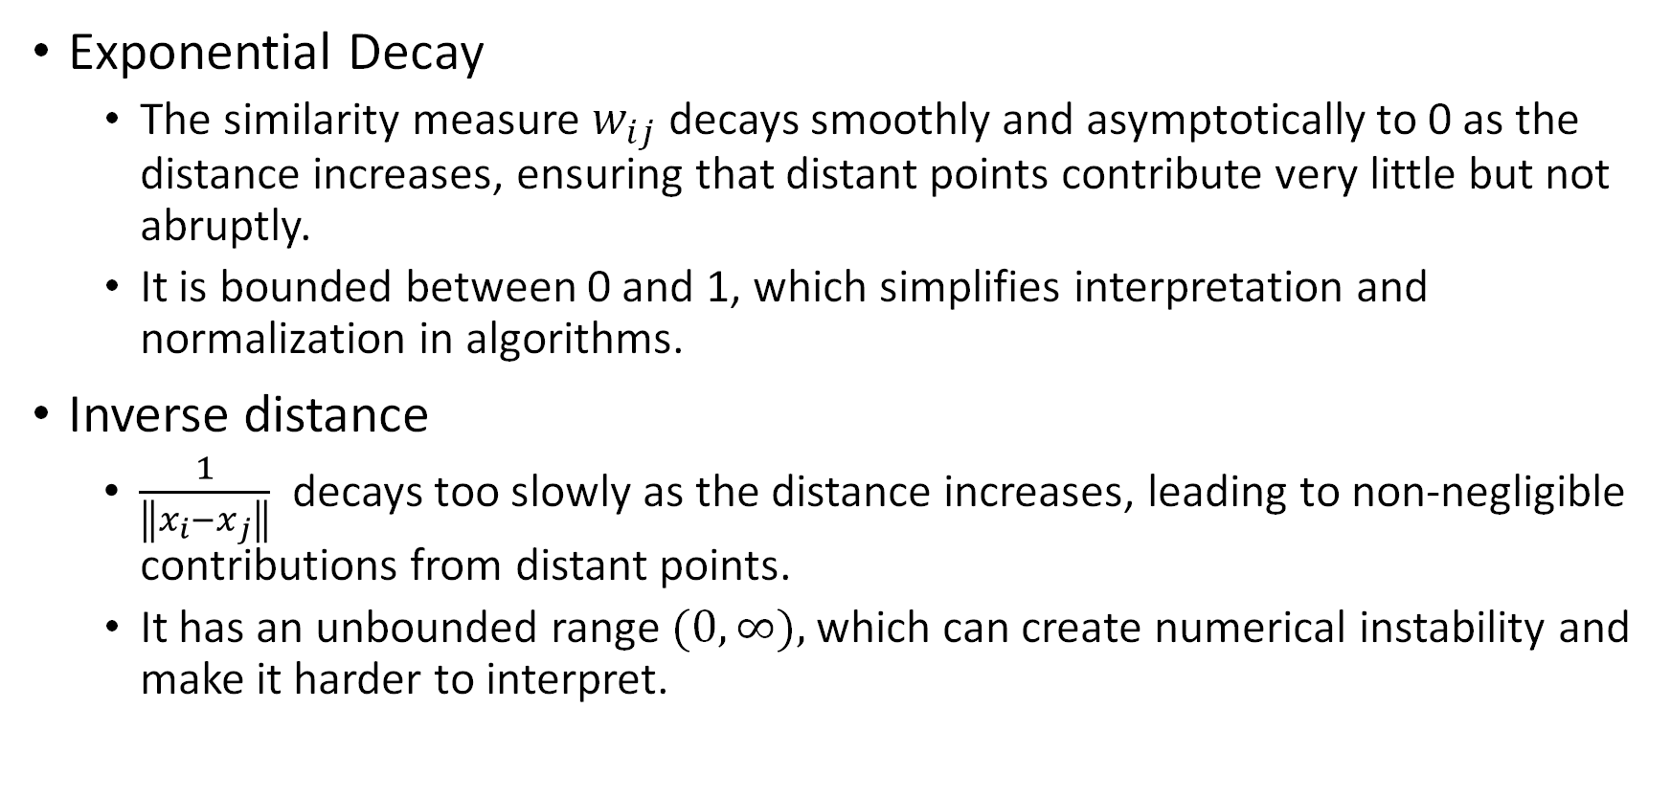
Gaussian similarity
Exponential Decay
The similarity measure $w_{ij}$ decays smoothly and asymptotically to 0 as the distance increases, ensuring that distant points contribute very little but not abruptly.
It is bounded between 0 and 1, which simplifies interpretation and normalization in algorithms.
Inverse distance
$\frac{1}{\left\|x_{i}−x_{j}\right\|}$ decays too slowly as the distance increases, leading to non-negligible contributions from distant points.
It has an unbounded range $(0,∞),$which can create numerical instability and make it harder to interpret.

Slide 28
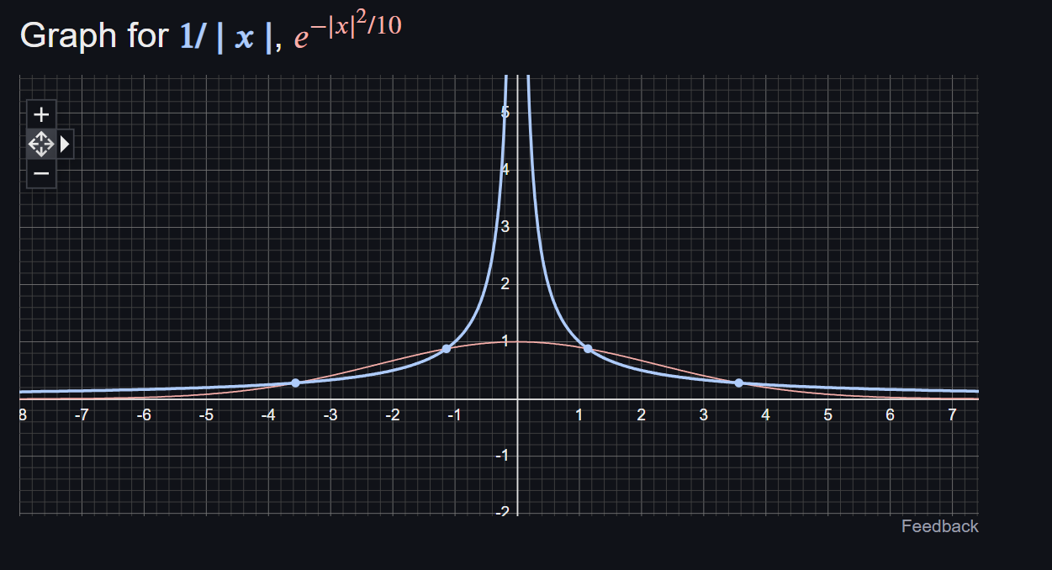

Slide 29
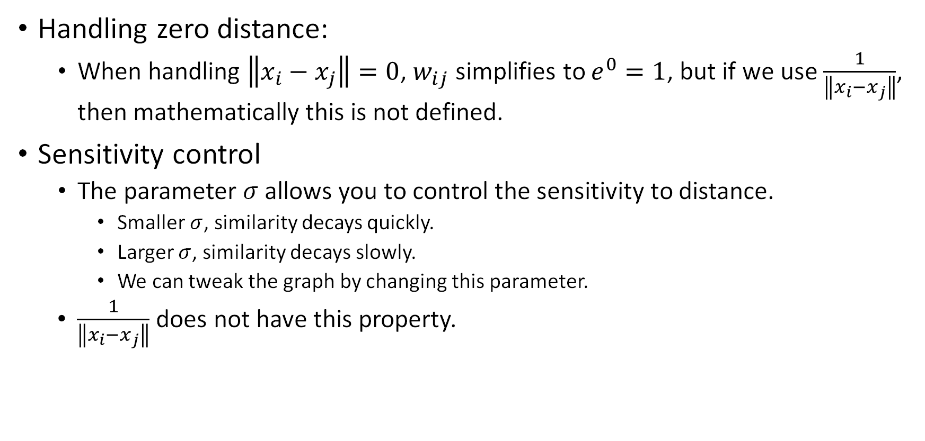
Gaussian similarity
Handling zero distance:
When handling $\left\|x_{i}−x_{j}\right\|=0$, $w_{ij}$ simplifies to $e^{0}=1$, but if we use $\frac{1}{\left\|x_{i}−x_{j}\right\|}$, then mathematically this is not defined.
Sensitivity control
The parameter $σ$ allows you to control the sensitivity to distance.
Smaller $σ$, similarity decays quickly.
Larger $σ$, similarity decays slowly.
We can tweak the graph by changing this parameter.
$\frac{1}{\left\|x_{i}−x_{j}\right\|}$ does not have this property.

Slide 30
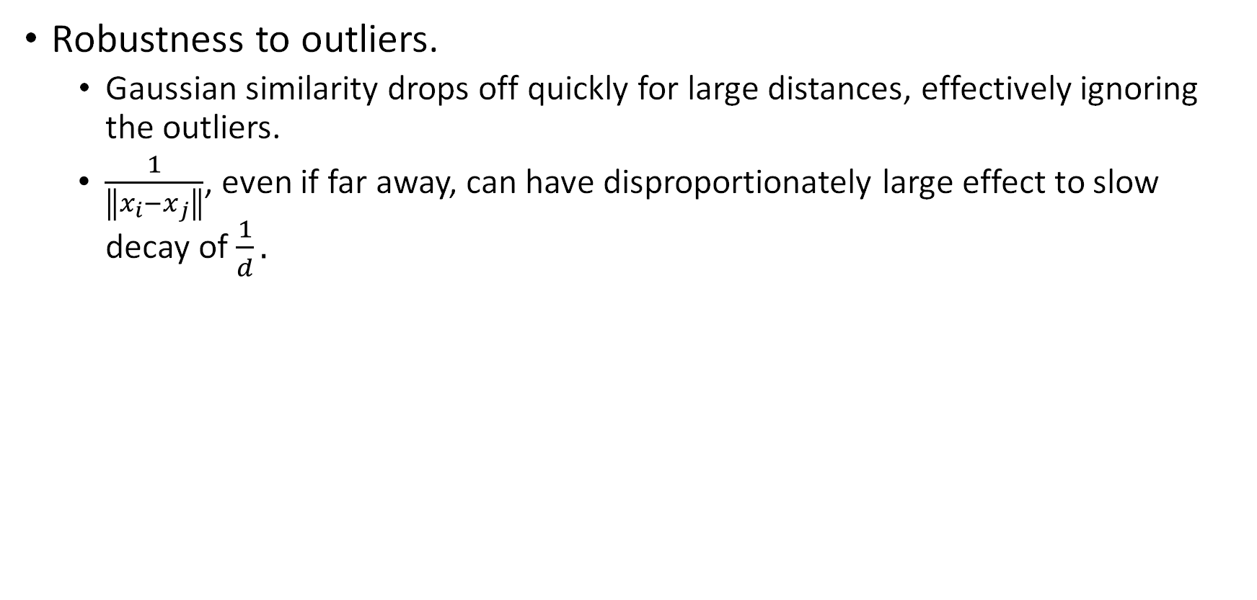
Gaussian similarity
Robustness to outliers.
Gaussian similarity drops off quickly for large distances, effectively ignoring the outliers.
$\frac{1}{\left\|x_{i}−x_{j}\right\|}$, even if far away, can have disproportionately large effect to slow decay of $\frac{1}{d}.$

Slide 31
Graphs from Data Matrix
Gaussian similarity with $σ=25$
$$\begin{matrix} & X_{1} & X_{2} & X_{3} \\ x_{1} & 0.2 & 1 & 12.3 \\ x_{2} & 1.3 & 4 & 89.23 \\ x_{3} & 5.6 & 5 & 56.1 \\ x_{4} & 4.5 & 7 & 47.3 \\ x_{5} & 7.3 & 12 & 45.23\end{matrix}$$
0 | 0.008709 | 0.207862 | 0.359302 | 0.366178
0.008709 | 0 | 0.409967 | 0.241611 | 0.196716
0.207862 | 0.409967 | 0 | 0.936019 | 0.87281
0.359302 | 0.241611 | 0.936019 | 0 | 0.970737
0.366178 | 0.196716 | 0.87281 | 0.970737 | 0

Slide 32
Graphs from Data Matrix
Gaussian similarity with $σ=25$
$$\begin{matrix} & X_{1} & X_{2} & X_{3} \\ x_{1} & 0.2 & 1 & 12.3 \\ x_{2} & 1.3 & 4 & 89.23 \\ x_{3} & 5.6 & 5 & 56.1 \\ x_{4} & 4.5 & 7 & 47.3 \\ x_{5} & 7.3 & 12 & 45.23\end{matrix}$$
 | x1 | x2 | x3 | x4 | x5
x1 | 0 | 0.008709 | 0.207862 | 0.359302 | 0.366178
x2 | 0.008709 | 0 | 0.409967 | 0.241611 | 0.196716
x3 | 0.207862 | 0.409967 | 0 | 0.936019 | 0.87281
x4 | 0.359302 | 0.241611 | 0.936019 | 0 | 0.970737
x5 | 0.366178 | 0.196716 | 0.87281 | 0.970737 | 0

Slide 33
Graphs from Data Matrix
Gaussian similarity with $σ=50$
$$\begin{matrix} & X_{1} & X_{2} & X_{3} \\ x_{1} & 0.2 & 1 & 12.3 \\ x_{2} & 1.3 & 4 & 89.23 \\ x_{3} & 5.6 & 5 & 56.1 \\ x_{4} & 4.5 & 7 & 47.3 \\ x_{5} & 7.3 & 12 & 45.23\end{matrix}$$
 | x1 | x2 | x3 | x4 | x5
x1 | 0 | 0.30549 | 0.675218 | 0.774221 | 0.777899
x2 | 0.30549 | 0 | 0.800179 | 0.701098 | 0.665978
x3 | 0.675218 | 0.800179 | 0 | 0.983606 | 0.966562
x4 | 0.774221 | 0.701098 | 0.983606 | 0 | 0.992603
x5 | 0.777899 | 0.665978 | 0.966562 | 0.992603 | 0

Slide 34
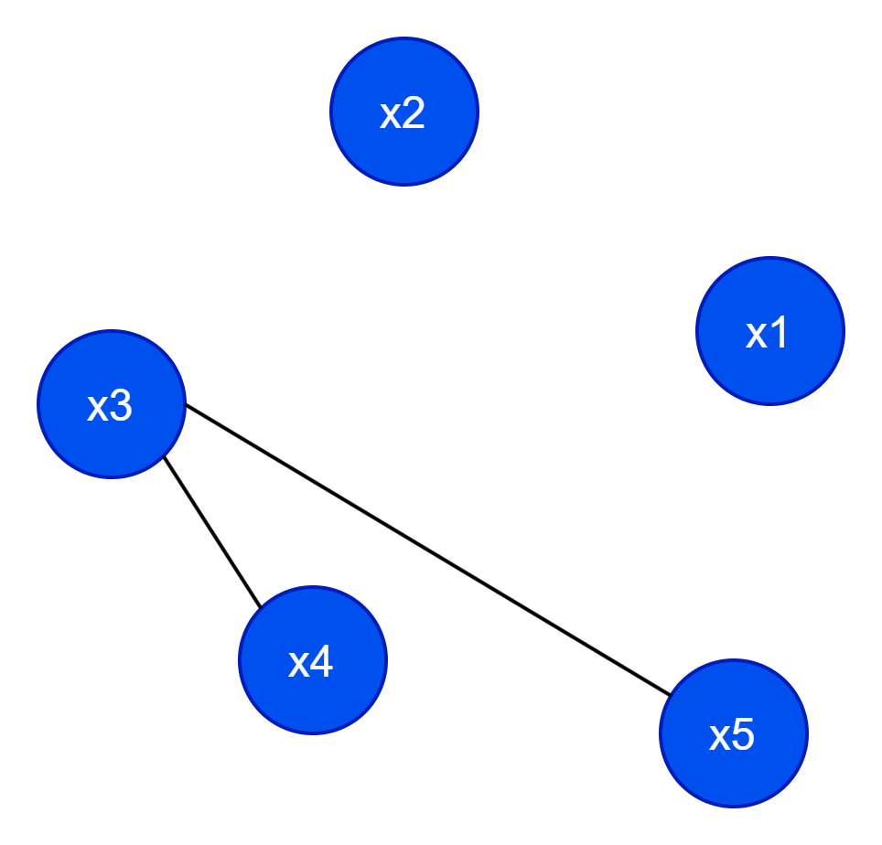
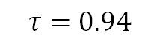
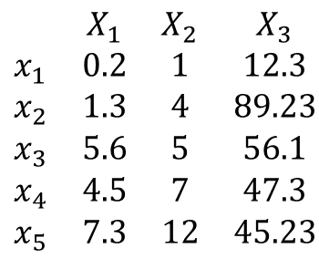


Creating a graph from matrix
$$τ=0.94$$
 | x1 | x2 | x3 | x4 | x5
x1 | 0 | 0.30549 | 0.675218 | 0.774221 | 0.777899
x2 | 0.30549 | 0 | 0.800179 | 0.701098 | 0.665978
x3 | 0.675218 | 0.800179 | 0 | 0.983606 | 0.966562
x4 | 0.774221 | 0.701098 | 0.983606 | 0 | 0.992603
x5 | 0.777899 | 0.665978 | 0.966562 | 0.992603 | 0
$$\begin{matrix} & X_{1} & X_{2} & X_{3} \\ x_{1} & 0.2 & 1 & 12.3 \\ x_{2} & 1.3 & 4 & 89.23 \\ x_{3} & 5.6 & 5 & 56.1 \\ x_{4} & 4.5 & 7 & 47.3 \\ x_{5} & 7.3 & 12 & 45.23\end{matrix}$$
 | x1 | x2 | x3 | x4 | x5
x1 | 0 | 0 | 0 | 0 | 0
x2 | 0 | 0 | 0 | 0 | 0
x3 | 0 | 0 | 0 | 1 | 1
x4 | 0 | 0 | 1 | 0 | 1
x5 | 0 | 0 | 1 | 1 | 0
$$sim(x_{i}, x_{j})=e^{−\frac{{\left\|x_{i}−x_{j}\right\|}^{2}}{2σ^{2}}}$$
$$A\left(i,j\right)=\left\{\begin{aligned}\begin{matrix}1 & ifsim\left(x_{i}, x_{j}\right)≥τ\end{matrix} \\ \begin{matrix}0 & otherwise \end{matrix}\end{aligned}\right.$$

Slide 35
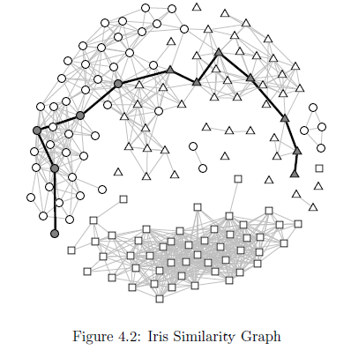
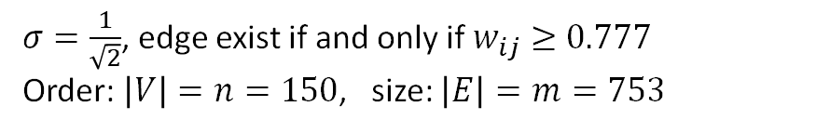
Iris Similarity Graph: Gaussian Similarity
$σ=\frac{1}{\sqrt{2}}$, edge exist if and only if $w_{ij}≥0.777$
Order: $\left|V\right|=n=150$, size: $\left|E\right|=m=753$

Slide 36
Topological graph attributes
Topological graph attributes refer to properties of a graph that describe its structure and connectivity without considering specific geometric or spatial embedding.
We say a graph attribute is:
Local if they apply only to a single node.
Global if they refer to the entire graph.

Slide 37
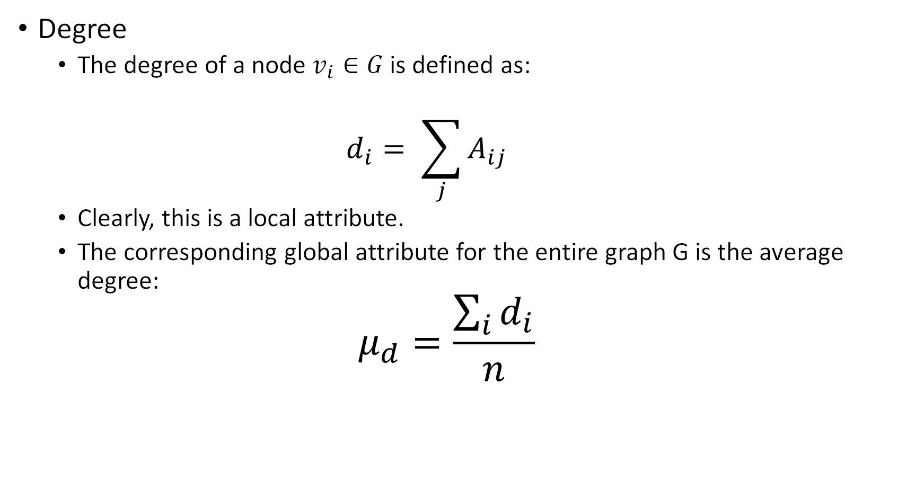
Degree
The degree of a node $v_{i}∈G$ is defined as:
$$d_{i}= \sum_{j}{A_{ij}}$$
Clearly, this is a local attribute.
The corresponding global attribute for the entire graph G is the average degree:
$$μ_{d}=\frac{\sum_{i}{d_{i}}}{n}$$

Slide 38
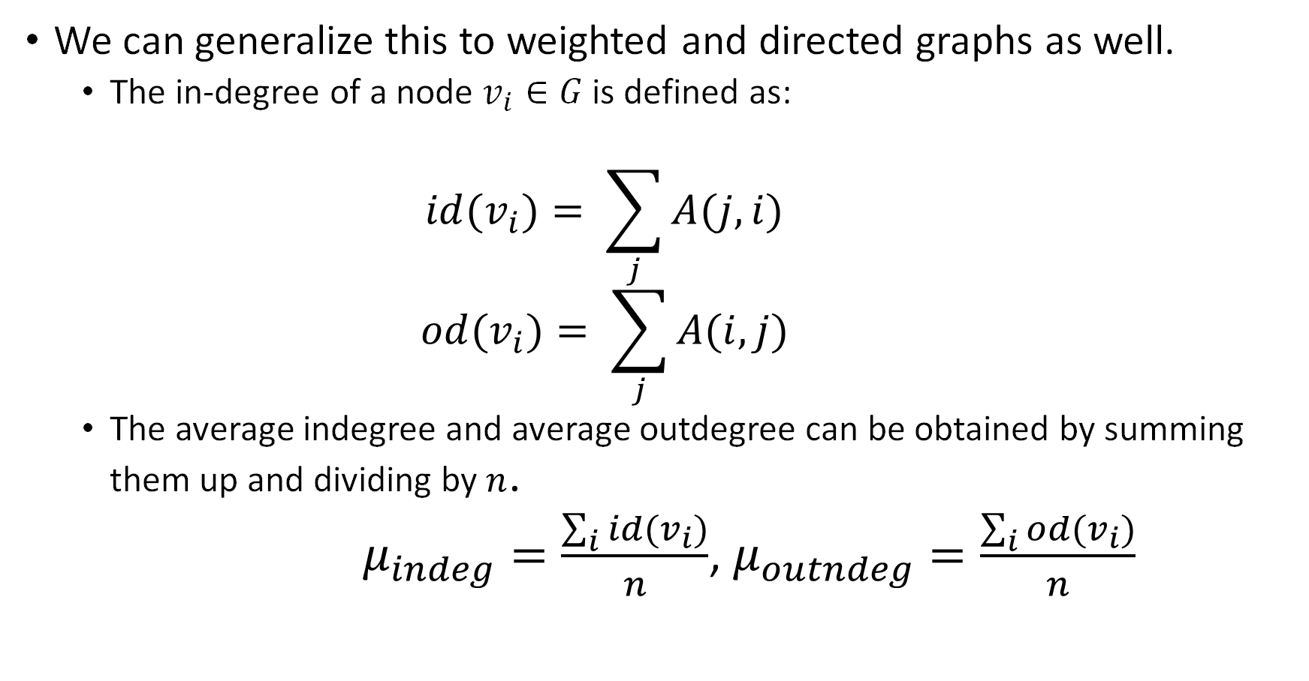
We can generalize this to weighted and directed graphs as well.
The in-degree of a node $v_{i}∈G$ is defined as:
$$id(v_{i})= \sum_{j}{A(j,i)}$$
$$od(v_{i})= \sum_{j}{A(i,j)}$$
The average indegree and average outdegree can be obtained by summing them up and dividing by $n$.
$μ_{indeg}=\frac{\sum_{i}{id(v_{i})}}{n}$, $μ_{outndeg}=\frac{\sum_{i}{od(v_{i})}}{n}$

Slide 39
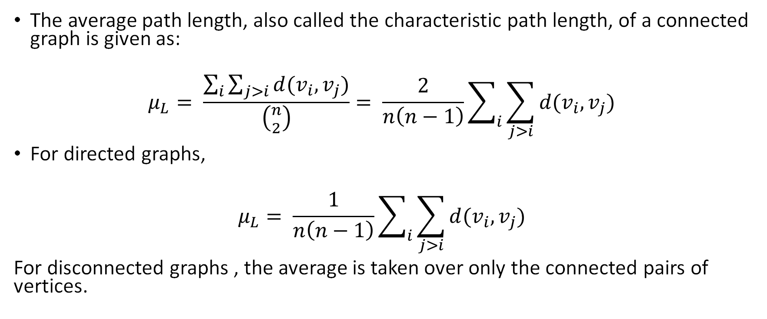
Average path length
The average path length, also called the characteristic path length, of a connected graph is given as:
$$μ_{L}= \frac{\sum_{i}{\sum_{j>i}{d(v_{i}, v_{j})}}}{\left({n \atop 2}\right)}= \frac{2}{n\left(n−1\right)}\sum_{i}{\sum_{j>i}{d(v_{i}, v_{j})}}$$
For directed graphs,
$$μ_{L}= \frac{1}{n\left(n−1\right)}\sum_{i}{\sum_{j>i}{d(v_{i}, v_{j})}}$$
For disconnected graphs , the average is taken over only the connected pairs of vertices.

Slide 40
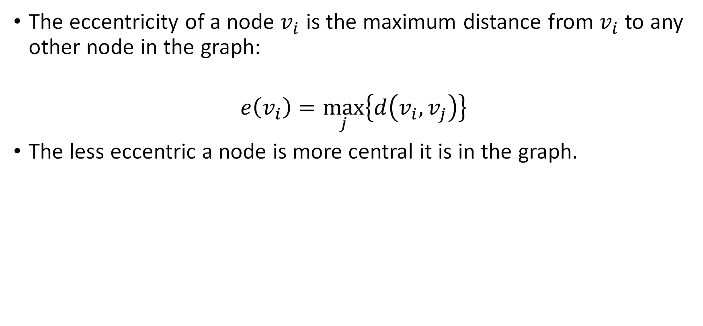
Eccentricity
The eccentricity of a node $v_{i}$ is the maximum distance from $v_{i}$ to any other node in the graph:
$$e\left(v_{i}\right)=\max_{j}\left\{d\left(v_{i}, v_{j}\right)\right\}$$
The less eccentric a node is more central it is in the graph.

Slide 41
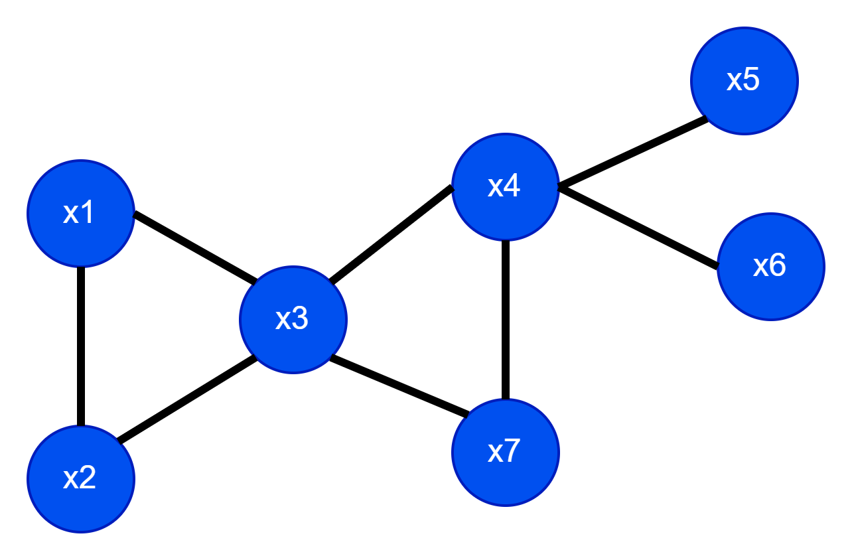
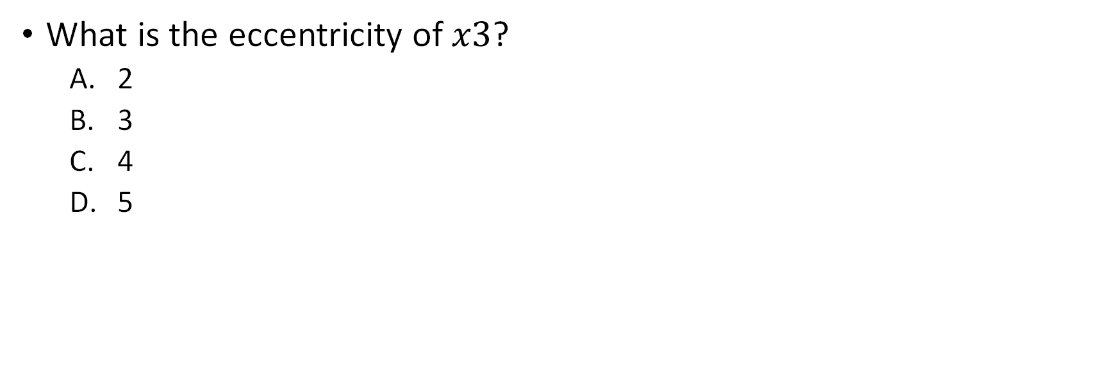
Example:
What is the eccentricity of $x3$?
2
3
4
5

Slide 42
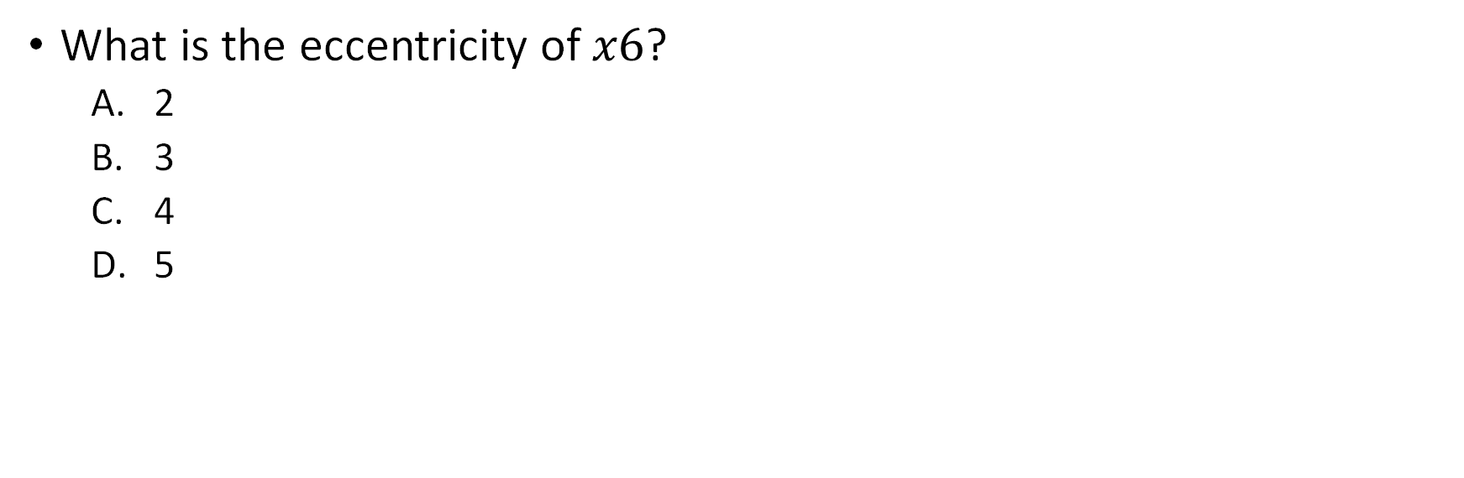
Example:
What is the eccentricity of $x6$?
2
3
4
5

Slide 43
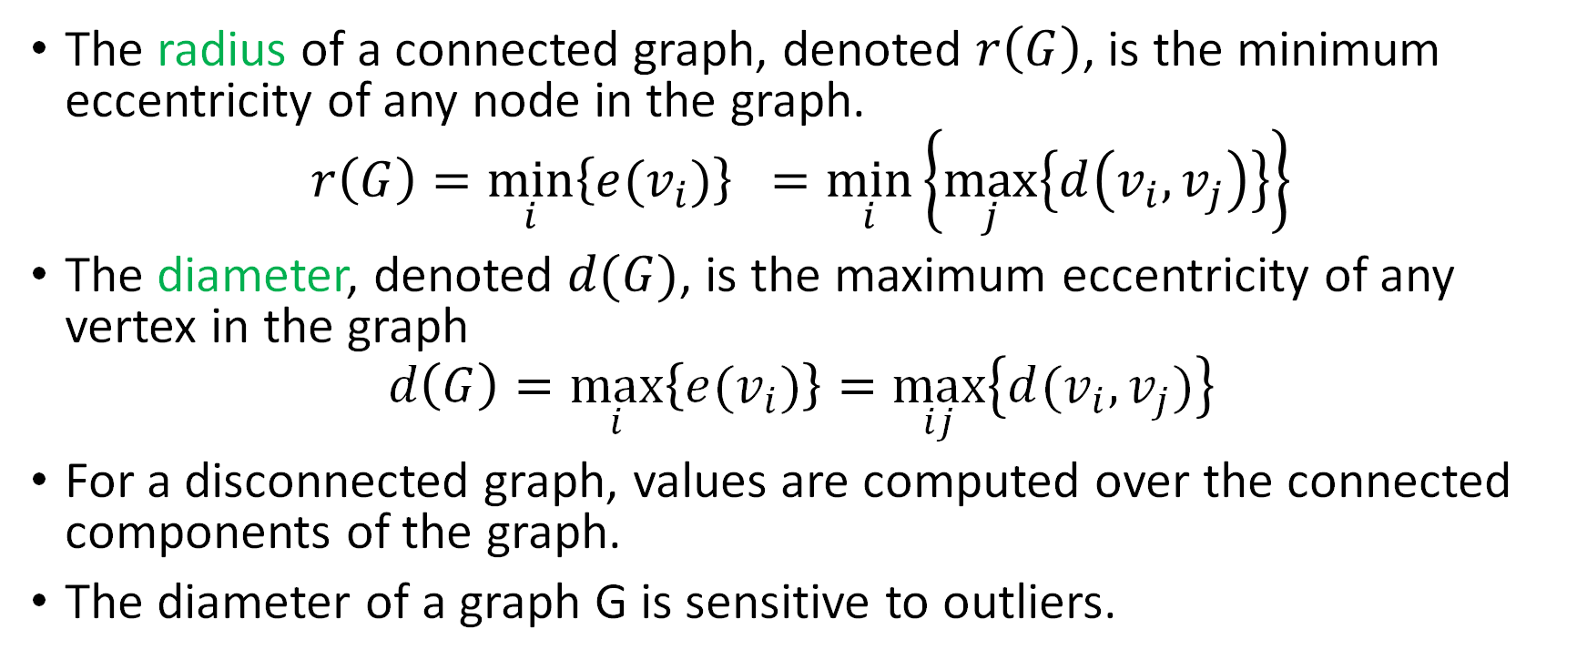
Radius and Diameter of a graph G
The radius of a connected graph, denoted $r\left(G\right)$, is the minimum eccentricity of any node in the graph.
$$r\left(G\right)=\min_{i}\left\{e(v_{i})\right\} =\min_{i}\left\{\max_{j}\left\{d\left(v_{i}, v_{j}\right)\right\}\right\}$$
The diameter, denoted $d(G)$, is the maximum eccentricity of any vertex in the graph
$$d\left(G\right)=\max_{i}\left\{e(v_{i})\right\}=\max_{ij}\left\{d(v_{i}, v_{j})\right\}$$
For a disconnected graph, values are computed over the connected components of the graph.
The diameter of a graph G is sensitive to outliers.

Slide 44
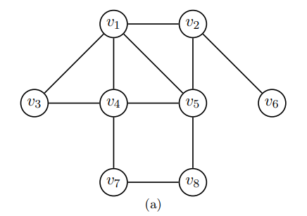
What is the radius and diameter of the following graph?
2
3
4
5

Slide 45
What is the radius and diameter of the following graph?
2
3
4
5

Slide 46
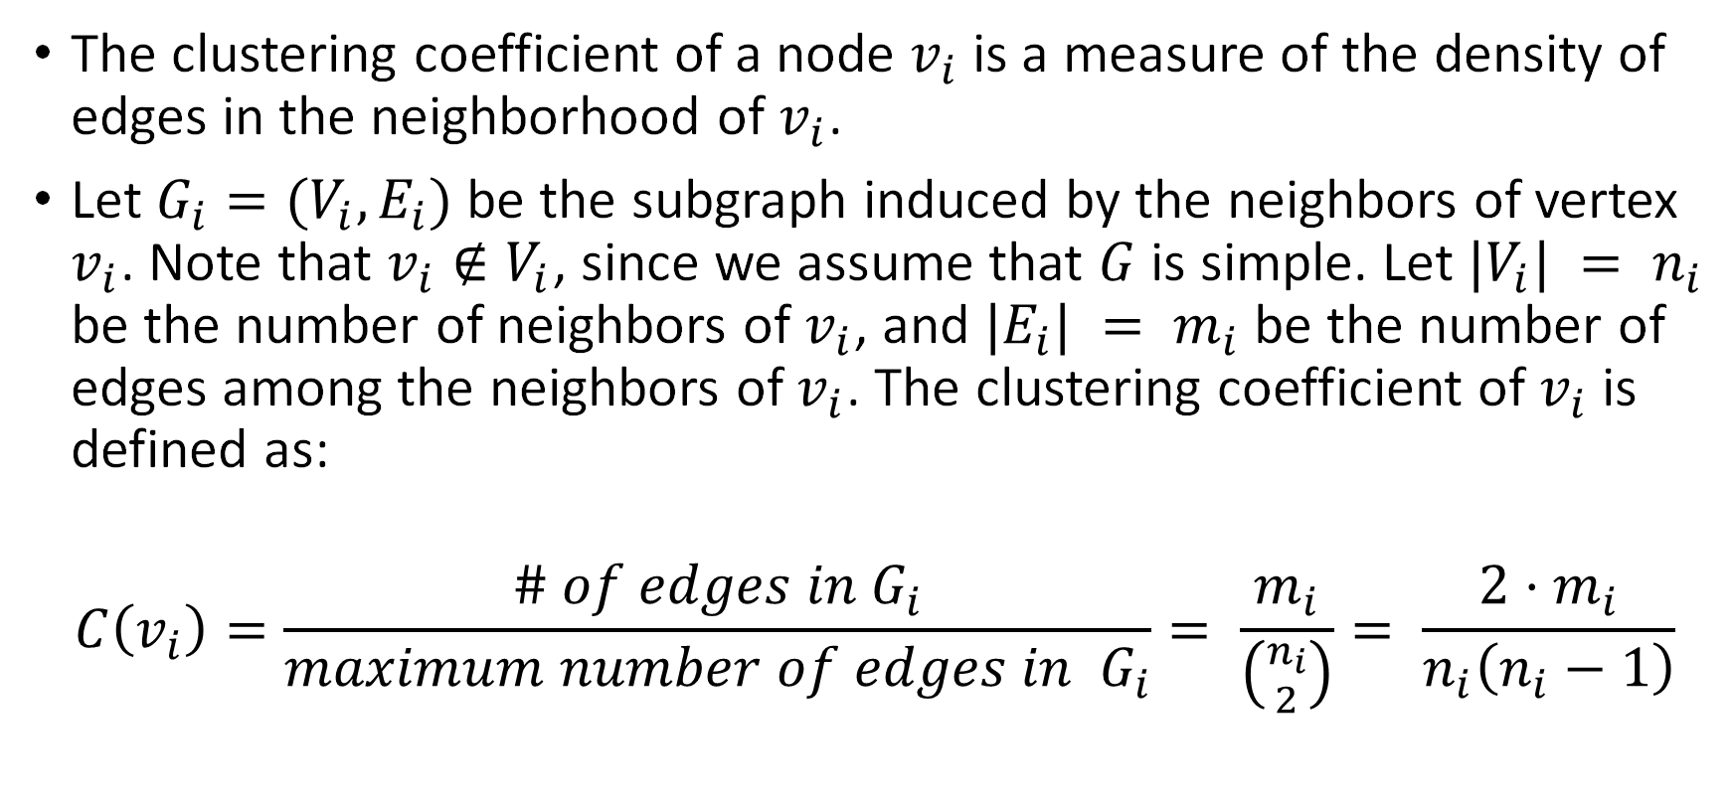
Clustering coefficient of a node
The clustering coefficient of a node $v_{i}$ is a measure of the density of edges in the neighborhood of $v_{i}$.
Let $G_{i}=(V_{i},E_{i})$ be the subgraph induced by the neighbors of vertex $v_{i}$. Note that $v_{i}∉V_{i}$, since we assume that $G$ is simple. Let $|V_{i}| = n_{i}$ be the number of neighbors of $v_{i}$, and $|E_{i}| = m_{i}$ be the number of edges among the neighbors of $v_{i}$. The clustering coefficient of $v_{i}$ is defined as:
$$C\left(v_{i}\right)=\frac{\# of edges in G_{i}}{maximum number of edges in G_{i}}= \frac{m_{i}}{\left({n_{i} \atop 2}\right)}= \frac{2⋅m_{i}}{n_{i}\left(n_{i}−1\right)}$$

Slide 47

What is the clustering coefficient of $v_{3}$?
1
1/3
1/2
1/6
6/10

Slide 48

What is the clustering coefficient of $v_{5}$?
1
1/3
1/2
1/6
6/10

Slide 49

What is the clustering coefficient of $v_{6}$?
1
1/3
1/2
1/6
6/10
Not defined

Slide 50
Clustering coefficient of a node
Note: Clustering coefficient of a node is not defined for nodes with degree less than 2.
Therefore, if we need, we can consider 0 for the clustering coefficient for nodes with degree less than 2.

Slide 51

Clustering coefficient of a node
How to interpret this value?
$C\left(v_{i}\right)=1→$ All neighbors are connected to each other.
$C\left(v_{i}\right)=0→$ None of the neighbors are connected to each other.
A higher clustering coefficient indicates a more tightly knit local community around the node.
Example:
Fraud Detection in Financial Networks
In a bank transaction network, accounts are nodes, and transactions form edges.
Fraud rings often have a high clustering coefficient since fraudulent accounts transfer money within a small, well-connected group.

Slide 52

Clustering coefficient of a graph
The clustering coefficient of a graph G is simply the average clustering coefficient over all the nodes, given as:
$$C\left(G\right)= \frac{1}{n}⋅\sum_{i}{C(v_{i})}$$

Slide 53

Clustering coefficient of a graph
The clustering coefficient of a graph G is simply the average clustering coefficient over all the nodes, given as:
$$C\left(G\right)= \frac{1}{n}⋅\sum_{i}{C(v_{i})}$$
What is the clustering coefficient of this graph?
3/8
3/16
5/16
1/2

Slide 54

$$C\left(G\right)=\frac{1}{8}⋅\left(\frac{3}{\left({4 \atop 2}\right)}+\frac{1}{\left({3 \atop 2}\right)}+1+\frac{2}{\left({4 \atop 2}\right)}+\frac{2}{\left({4 \atop 2}\right)}+0+0+0\right)=\frac{2.5}{8}=\frac{5}{16}$$

Slide 55
Clustering coefficient of a graph
The clustering coefficient of a graph G is simply the average clustering coefficient over all the nodes, given as:
$$C\left(G\right)= \frac{1}{n}⋅\sum_{i}{C(v_{i})}$$
What is the clustering coefficient of this graph?
3/8
3/16
5/16
1/2

Slide 56

Efficiency
The efficiency for a pair of nodes $v_{i}$ and $v_{j}$ is defined as $\frac{1}{d\left(v_{i}, v_{j}\right)}$
If $v_{i}$ and $v_{j}$ are not connected, then efficiency between these two vertices is $\frac{1}{∞} ≈0$.
Smaller the distance between two nodes, these nodes are efficient in communicating between them.
The efficiency of a graph is defined as $G$ is defined as the average efficiency of over all pairs of nodes.
$$\frac{2}{n⋅\left(n−1\right)}⋅\sum_{i}{\sum_{j>i}{\frac{1}{d\left(v_{i}, v_{j}\right)}}}$$

Slide 57

Measure of centrality
The notion of centrality is used to rank the vertices of a graph in terms of how “central” or important they are.
A centrality can be formally defined as a function:
$$c:V→ ℝ$$
$$that induces a total order on V$$
We say that $v_{i}$ is at least as central as $v_{j}$ if $c\left(v_{i}\right)≥c(v_{j}).$
A set has a total order if it has a partial order and every pair of elements in the set are comparable.

Slide 58

Degree centrality
The simplest notion of centrality is the degree $d_{i}$ of a vertex $v_{i}$.
the higher the degree the more important or central the vertex.
For directed graphs, one may further consider the indegree centrality and outdegree centrality of a vertex.

Slide 59



Degree centrality
$$d\left(v_{i}\right)= \sum_{j}^{n}{A(i, j)}$$
$$d\left(x_{3}\right)=\sum_{1}^{n}{A(3, j)}=4$$

Slide 60


Degree centrality
$$d\left(v_{i}\right)= \sum_{j}^{n}{A(i, j)}$$
$$d\left(x_{5}\right)=\sum_{1}^{n}{A\left(5,j\right)=1}$$

Slide 61




Degree centrality
$$d\left(x_{3}\right)=\sum_{1}^{n}{A(3, j)}=4$$
$$d\left(x_{5}\right)=\sum_{1}^{n}{A\left(5,j\right)=1}$$
$x3$ has higher importance than $x5$ according to degree centrality.

Slide 62

Eccentricity Centrality
Eccentricity centrality is thus defined as follows
$$c\left(v_{i}\right)=\frac{1}{e\left(v_{i}\right)}=\frac{1}{\max_{j}\left\{d(v_{i}, v_{j})\right\} }$$
The less eccentric a node is the more central it is.

Slide 63


What is the eccentric centrality of $x3$?
½
1/3
4
2
3

Slide 64

Closedness centrality
The closeness centrality uses the sum of all the distances to rank how central a node is.
$$c\left(v_{i}\right)=\frac{1}{\sum_{j}{d\left(v_{i}, v_{j}\right)}}$$
A node $v_{i}$ with the smallest total distance, $\sum_{j}{d\left(v_{i}, v_{j}\right)}$is called the median node.
Why is this important?

Slide 65
Closedness centrality
Closedness centrality tries to minimize the total distance over all the other nodes, and thus, a median node, which has the highest closedness centrality, is the optimal one to, say, locate a facility that minimizes the distance to all other points.

Slide 66

Closedness centrality
What is the closedness centrality of $x3$?
1/8
1/3
3
4
8

Slide 67

Closedness centrality
What is the eccentricity centrality of $x3$?
½
1/3
4
2
3

Slide 68

Betweenness centrality
For a given vertex $v_{i}$ the betweenness centrality measures how many shortest paths between all pairs of vertices include $v_{i}$.
This gives an indication as to the central “monitoring” role played by $v_{i}$ for various pairs of nodes.

Slide 69


Betweenness centrality
Let $η_{jk}$ denote the number of shortest paths between vertices $v_{j}$ and $v_{k}$, and let
$η_{jk}(v_{i})$ denote the number of such paths that include or contain $v_{i}$, then the fraction of paths through $v_{i}$ is denoted as
$$γ_{jk}\left(v_{i}\right)=\frac{η_{jk}\left(v_{i}\right)}{η_{jk}}.$$
If the two vertices $v_{j}$ and $v_{k}$ are not connected, we assume $γ_{jk} = 0$.
$$c\left(v_{i}\right)= \sum_{j≠i}{\sum_{\begin{aligned}k≠i \\ k>j\end{aligned}}{γ_{jk}}}$$

Slide 70

What is the betweenness centrality centrality of $v_{5}$?

Slide 71

 | Shortest paths | Shortest paths through $v_{5}$ $η_{jk}(v_{5})$
$$η_{12}$$ | 1 | 0
$$η_{13}$$ | 1 | 0
$$η_{14}$$ | 1 | 0
$$η_{16}$$ | 1 | 0
$$η_{17}$$ | 1 | 0
$$η_{18}$$ | 1 | 1
$$η_{23}$$ | 1 | 0
$$η_{24}$$ | 2 | 1
$$η_{26}$$ | 1 | 0
$$η_{27}$$ | 3 | 2
$$η_{28}$$ | 1 | 1
$$η_{34}$$ | 1 | 0
…

Slide 72
What is the betweenness centrality centrality of $v_{5}$?
$$c\left(v_{5}\right)=γ_{18}\text{+ }γ_{24}\text{+ }γ_{27}\text{+ }γ_{28}\text{ + }γ_{38}\text{+ }γ_{46}\text{ + }γ_{48}\text{ +} γ_{67} \text{+ }γ_{68}$$
$$c\left(v_{5}\right)=1+\frac{1}{2}+\frac{2}{3}+1+\frac{2}{3}+\frac{1}{2}+\frac{1}{2}+\frac{2}{3}=6.5$$

Slide 73


Slide 74
Centrality measures for directed graphs.
Up until now we only looked at undirected graphs.
Let’s look at how we can use centrality measures for directed graphs.
Especially in the context of the web, like citation networks, and centrality measures that are best suited for large-scale web graphs.

Slide 75
Prestige (Eigenvector centrality)
The idea is, the more the links that point to a given node, the higher its prestige.
The prestige does not simply depend on the indegree, it also (recursively) depends on the prestige of the nodes that point to it.

Slide 76


Prestige (Eigenvector centrality)
Recap:
Let $G=\left(V, E\right)$, be a directed graph, with $\left|V\right|=n$. The adjacency matrix of $G$ is a $n×n$ asymmetric matrix $A$ is given as:
$$A\left(u,v\right)=\left\{\begin{aligned}\begin{matrix}1 & if \left(u,v\right)∈E\end{matrix} \\ \begin{matrix}0 & if \left(u,v\right)∉E\end{matrix}\end{aligned}\right.$$
$$\begin{matrix} & x_{1} & x_{2} & x_{3} & x_{4} & x_{5} \\ x_{1} & 0 & 0 & 1 & 0 & 0 \\ x_{2} & 1 & 0 & 1 & 0 & 1 \\ x_{3} & 0 & 0 & 0 & 1 & 1 \\ x_{4} & 1 & 0 & 0 & 0 & 1 \\ x_{5} & 1 & 0 & 0 & 0 & 0\end{matrix}$$

Slide 77


Prestige (Eigenvector centrality)
Idea: If there are many prestigious nodes pointing to a node, then the node is itself prestigious. (recursive definition)
$$p\left(x_{5}\right)=p\left(x_{4}\right)+p\left(x_{3}\right)+p\left(x_{2}\right)$$
$$\begin{matrix} & x_{1} & x_{2} & x_{3} & x_{4} & x_{5} \\ x_{1} & 0 & 0 & 1 & 0 & 0 \\ x_{2} & 1 & 0 & 1 & 0 & 1 \\ x_{3} & 0 & 0 & 0 & 1 & 1 \\ x_{4} & 1 & 0 & 0 & 0 & 1 \\ x_{5} & 1 & 0 & 0 & 0 & 0\end{matrix}$$
$$p=\left(\begin{matrix}p\left(x_{1}\right) \\ p\left(x_{2}\right) \\ \begin{aligned}p\left(x_{3}\right) \\ p\left(x_{4}\right) \\ p\left(x_{5}\right)\end{aligned}\end{matrix}\right)$$

Slide 78

Prestige (Eigenvector centrality)
$$p\left(x_{5}\right)=p\left(x_{4}\right)+p\left(x_{3}\right)+p\left(x_{2}\right)$$
$$p\left(x_{1}\right)=p\left(x_{2}\right)+p\left(x_{4}\right)+p\left(x_{5}\right)$$
$$p\left(x_{2}\right)=0$$
$$p\left(x_{3}\right)=p\left(x_{1}\right)+p\left(x_{2}\right)$$
$$p\left(x_{4}\right)=p\left(x_{3}\right)$$
$$\begin{matrix} & x_{1} & x_{2} & x_{3} & x_{4} & x_{5} \\ x_{1} & 0 & 0 & 1 & 0 & 0 \\ x_{2} & 1 & 0 & 1 & 0 & 1 \\ x_{3} & 0 & 0 & 0 & 1 & 1 \\ x_{4} & 1 & 0 & 0 & 0 & 1 \\ x_{5} & 1 & 0 & 0 & 0 & 0\end{matrix}$$
$$p=\left(\begin{matrix}p\left(x_{1}\right) \\ p\left(x_{2}\right) \\ \begin{aligned}p\left(x_{3}\right) \\ p\left(x_{4}\right) \\ p\left(x_{5}\right)\end{aligned}\end{matrix}\right)$$

Slide 79
Prestige (Eigenvector centrality)
Circular Dependencies: Prestige often relies on the prestige of the nodes pointing to you. Imagine a simple cycle: A -> B -> C -> A. To calculate A's prestige, we need B's. To calculate B's, we need C's. To calculate C's, we need A's! This creates a circular dependency. We can't just start calculating because we don't have the "starting points."
$$\begin{matrix} & x_{1} & x_{2} & x_{3} & x_{4} & x_{5} \\ x_{1} & 0 & 0 & 1 & 0 & 0 \\ x_{2} & 1 & 0 & 1 & 0 & 1 \\ x_{3} & 0 & 0 & 0 & 1 & 1 \\ x_{4} & 1 & 0 & 0 & 0 & 1 \\ x_{5} & 1 & 0 & 0 & 0 & 0\end{matrix}$$
$$p=\left(\begin{matrix}p\left(x_{1}\right) \\ p\left(x_{2}\right) \\ \begin{aligned}p\left(x_{3}\right) \\ p\left(x_{4}\right) \\ p\left(x_{5}\right)\end{aligned}\end{matrix}\right)$$

Slide 80

Linear algebra review..
We need some additional linear algebra knowledge.. Let’s do a recap
Transpose of a matrix:
$A=\left(\begin{matrix}1 & 3 & 0 \\ 0 & 2 & 4 \\ −4 & 1 & 2\end{matrix}\right)$ $A=\left(a_{ij}\right), then A_{ij}^{T}={(a}_{ji})$
The element in row $i$ and column $j$ of $A^{T}$ is the element in row $j$ and column $i$ of $A.$
$$A^{T}=\left(\begin{matrix}1 & 0 & −4 \\ 3 & 2 & 1 \\ 0 & 4 & 2\end{matrix}\right)$$

Slide 81

Matrix vector multiplication
Matrix vector multiplication.
$$A=\left(\begin{matrix}1 & 3 & 0 \\ 0 & 2 & 4 \\ −4 & 1 & 2\end{matrix}\right) v=\left(\begin{matrix}2 \\ 1 \\ 3\end{matrix}\right)$$
For $A∈ℝ^{m×n}, v∈ℝ^{n}, then the ith element of Av is:{\left(Av\right)}_{i}= \sum_{j=1}^{n}{A_{ij}v_{j}}$

Slide 82

Matrix vector multiplication
Matrix vector multiplication.
$$A=\left(\begin{matrix}1 & 3 & 0 \\ 0 & 2 & 4 \\ −4 & 1 & 2\end{matrix}\right) v=\left(\begin{matrix}2 \\ 1 \\ 3\end{matrix}\right)$$
For $A∈ℝ^{m×n}, v∈ℝ^{n}, then the ith element of Av is:{\left(Av\right)}_{i}= \sum_{j=1}^{n}{A_{ij}v_{j}}$
$$Av=\left(\begin{matrix}1 & 3 & 0 \\ 0 & 2 & 4 \\ −4 & 1 & 2\end{matrix}\right)\left(\begin{matrix}2 \\ 1 \\ 3\end{matrix}\right)=\left(\begin{matrix}1\left(2\right)+3\left(1\right)+0(3) \\ 0\left(2\right)+2\left(1\right)+4(3) \\ −4\left(2\right)+1\left(1\right)+2(3)\end{matrix}\right)=\left(\begin{matrix}5 \\ 14 \\ −1\end{matrix}\right)$$

Slide 83

Matrix vector multiplication
Find the product of $Av$
$$A=\left(\begin{matrix}1 & 3 & 0 \\ 0 & 2 & 4 \\ −4 & 1 & 2\end{matrix}\right) v=\left(\begin{matrix}1 \\ 1 \\ 2\end{matrix}\right)$$
For $A∈ℝ^{m×n}, v∈ℝ^{n}, then the ith element of Av is:{\left(Av\right)}_{i}= \sum_{j=1}^{n}{A_{ij}v_{j}}$

Slide 84

Matrix vector multiplication
Find the product of $Av$
$$A=\left(\begin{matrix}1 & 3 & 0 \\ 0 & 2 & 4 \\ −4 & 1 & 2\end{matrix}\right) v=\left(\begin{matrix}1 \\ 1 \\ 2\end{matrix}\right)$$
For $A∈ℝ^{m×n}, v∈ℝ^{n}, then the ith element of Av is:{\left(Av\right)}_{i}= \sum_{j=1}^{n}{A_{ij}v_{j}}$
$$Av=\left(\begin{matrix}1 & 3 & 0 \\ 0 & 2 & 4 \\ −4 & 1 & 2\end{matrix}\right)\left(\begin{matrix}1 \\ 1 \\ 2\end{matrix}\right)=\left(\begin{matrix}1\left(1\right)+3\left(1\right)+0(2) \\ 0\left(1\right)+2\left(1\right)+4(2) \\ −4\left(1\right)+1\left(1\right)+2(2)\end{matrix}\right)=\left(\begin{matrix}4 \\ 10 \\ 1\end{matrix}\right)$$

Slide 85







Prestige (Eigenvector centrality)
$$A=\left(\begin{matrix}0 & 0 & 1 & 0 & 0 \\ 1 & 0 & 1 & 0 & 1 \\ 0 & 0 & 0 & 1 & 1 \\ 1 & 0 & 0 & 0 & 1 \\ 1 & 0 & 0 & 0 & 0\end{matrix}\right)$$
Idea: First map this calculation to matrix multiplication
$$A^{T}=\left(\begin{matrix}0 & 1 & 0 & 1 & 1 \\ 0 & 0 & 0 & 0 & 0 \\ 1 & 1 & 0 & 0 & 0 \\ 0 & 0 & 1 & 0 & 0 \\ 0 & 1 & 1 & 1 & 0\end{matrix}\right)$$
$$p=\left(\begin{matrix}p\left(x_{1}\right) \\ p\left(x_{2}\right) \\ \begin{aligned}p\left(x_{3}\right) \\ p\left(x_{4}\right) \\ p\left(x_{5}\right)\end{aligned}\end{matrix}\right)$$
We took a row of the transpose of the $A$
$$p\left(x_{3}\right)= \sum_{u}{A\left(u,x_{3}\right)⋅p\left(u\right)}$$
$$p\left(x_{3}\right)= \sum_{u}{A^{T}\left(x_{3},u\right)⋅p\left(u\right)}$$
$$p\left(x_{3}\right)=A_{3∗}^{T}p=\left(\begin{matrix}1 & 1 & 0 & 0 & 0\end{matrix}\right)\left(\begin{matrix}p\left(x_{1}\right) \\ p\left(x_{2}\right) \\ \begin{aligned}p\left(x_{3}\right) \\ p\left(x_{4}\right) \\ p\left(x_{5}\right)\end{aligned}\end{matrix}\right)=p\left(x_{1}\right)+p\left(x_{2}\right)$$

Slide 86




Prestige (Eigenvector centrality)
Idea: First map this calculation to matrix multiplication
$$A=\left(\begin{matrix}0 & 0 & 1 & 0 & 0 \\ 1 & 0 & 1 & 0 & 1 \\ 0 & 0 & 0 & 1 & 1 \\ 1 & 0 & 0 & 0 & 1 \\ 1 & 0 & 0 & 0 & 0\end{matrix}\right)$$
$$A^{T}=\left(\begin{matrix}0 & 1 & 0 & 1 & 1 \\ 0 & 0 & 0 & 0 & 0 \\ 1 & 1 & 0 & 0 & 0 \\ 0 & 0 & 1 & 0 & 0 \\ 0 & 1 & 1 & 1 & 0\end{matrix}\right)$$
$$p=\left(\begin{matrix}p\left(x_{1}\right) \\ p\left(x_{2}\right) \\ \begin{aligned}p\left(x_{3}\right) \\ p\left(x_{4}\right) \\ p\left(x_{5}\right)\end{aligned}\end{matrix}\right)$$
$$p\left(x_{2}\right)=A_{2∗}^{T}p=\left(\begin{matrix}0 & 0 & 0 & 0 & 0\end{matrix}\right)\left(\begin{matrix}p\left(x_{1}\right) \\ p\left(x_{2}\right) \\ \begin{aligned}p\left(x_{3}\right) \\ p\left(x_{4}\right) \\ p\left(x_{5}\right)\end{aligned}\end{matrix}\right)=0$$

Slide 87





Prestige (Eigenvector centrality)
Idea: First map this calculation to matrix multiplication.
Consider the matrix $A^{T}p$.
Since each row of this column vector be the prestige of the corresponding node:
$p=A^{T}p$
$$A=\left(\begin{matrix}0 & 0 & 1 & 0 & 0 \\ 1 & 0 & 1 & 0 & 1 \\ 0 & 0 & 0 & 1 & 1 \\ 1 & 0 & 0 & 0 & 1 \\ 1 & 0 & 0 & 0 & 0\end{matrix}\right)$$
$$A^{T}=\left(\begin{matrix}0 & 1 & 0 & 1 & 1 \\ 0 & 0 & 0 & 0 & 0 \\ 1 & 1 & 0 & 0 & 0 \\ 0 & 0 & 1 & 0 & 0 \\ 0 & 1 & 1 & 1 & 0\end{matrix}\right)$$
$$p=\left(\begin{matrix}p\left(x_{1}\right) \\ p\left(x_{2}\right) \\ \begin{aligned}p\left(x_{3}\right) \\ p\left(x_{4}\right) \\ p\left(x_{5}\right)\end{aligned}\end{matrix}\right)$$
$$\left(\begin{matrix}p\left(x_{1}\right) \\ p\left(x_{2}\right) \\ \begin{aligned}p\left(x_{3}\right) \\ p\left(x_{4}\right) \\ p\left(x_{5}\right)\end{aligned}\end{matrix}\right)=\left(\begin{matrix}0 & 1 & 0 & 1 & 1 \\ 0 & 0 & 0 & 0 & 0 \\ 1 & 1 & 0 & 0 & 0 \\ 0 & 0 & 1 & 0 & 0 \\ 0 & 1 & 1 & 1 & 0\end{matrix}\right)\left(\begin{matrix}p\left(x_{1}\right) \\ p\left(x_{2}\right) \\ \begin{aligned}p\left(x_{3}\right) \\ p\left(x_{4}\right) \\ p\left(x_{5}\right)\end{aligned}\end{matrix}\right)$$

Slide 88





Prestige (Eigenvector centrality)
Idea: First map this calculation to matrix multiplication.
Consider the matrix $A^{T}p$.
Since each row of this column vector be the prestige of the corresponding node:
$p=A^{T}p$
$$A=\left(\begin{matrix}0 & 0 & 1 & 0 & 0 \\ 1 & 0 & 1 & 0 & 1 \\ 0 & 0 & 0 & 1 & 1 \\ 1 & 0 & 0 & 0 & 1 \\ 1 & 0 & 0 & 0 & 0\end{matrix}\right)$$
$$A^{T}=\left(\begin{matrix}0 & 1 & 0 & 1 & 1 \\ 0 & 0 & 0 & 0 & 0 \\ 1 & 1 & 0 & 0 & 0 \\ 0 & 0 & 1 & 0 & 0 \\ 0 & 1 & 1 & 1 & 0\end{matrix}\right)$$
$$p=\left(\begin{matrix}p\left(x_{1}\right) \\ p\left(x_{2}\right) \\ \begin{aligned}p\left(x_{3}\right) \\ p\left(x_{4}\right) \\ p\left(x_{5}\right)\end{aligned}\end{matrix}\right)$$
$$\left(\begin{matrix}p\left(x_{1}\right) \\ p\left(x_{2}\right) \\ \begin{aligned}p\left(x_{3}\right) \\ p\left(x_{4}\right) \\ p\left(x_{5}\right)\end{aligned}\end{matrix}\right)=\left(\begin{matrix}0 & 1 & 0 & 1 & 1 \\ 0 & 0 & 0 & 0 & 0 \\ 1 & 1 & 0 & 0 & 0 \\ 0 & 0 & 1 & 0 & 0 \\ 0 & 1 & 1 & 1 & 0\end{matrix}\right)\left(\begin{matrix}p\left(x_{1}\right) \\ p\left(x_{2}\right) \\ \begin{aligned}p\left(x_{3}\right) \\ p\left(x_{4}\right) \\ p\left(x_{5}\right)\end{aligned}\end{matrix}\right)$$
How do we solve this? (basically, prestige vector is an eigenvector of the $A^{T}$ matrix.)
We use an algorithm called power iteration method to retrieve the dominant eigenvector of $A^{T}$.

Slide 89






Prestige (Eigenvector centrality)
Idea: First map this calculation to matrix multiplication.
Consider the matrix $A^{T}p$.
Since each row of this column vector be the prestige of the corresponding node:
$p=A^{T}p$
$$A=\left(\begin{matrix}0 & 0 & 1 & 0 & 0 \\ 1 & 0 & 1 & 0 & 1 \\ 0 & 0 & 0 & 1 & 1 \\ 1 & 0 & 0 & 0 & 1 \\ 1 & 0 & 0 & 0 & 0\end{matrix}\right)$$
$$A^{T}=\left(\begin{matrix}0 & 1 & 0 & 1 & 1 \\ 0 & 0 & 0 & 0 & 0 \\ 1 & 1 & 0 & 0 & 0 \\ 0 & 0 & 1 & 0 & 0 \\ 0 & 1 & 1 & 1 & 0\end{matrix}\right)$$
$$p=\left(\begin{matrix}p\left(x_{1}\right) \\ p\left(x_{2}\right) \\ \begin{aligned}p\left(x_{3}\right) \\ p\left(x_{4}\right) \\ p\left(x_{5}\right)\end{aligned}\end{matrix}\right)$$
$$\left(\begin{matrix}p\left(x_{1}\right) \\ p\left(x_{2}\right) \\ \begin{aligned}p\left(x_{3}\right) \\ p\left(x_{4}\right) \\ p\left(x_{5}\right)\end{aligned}\end{matrix}\right)=\left(\begin{matrix}0 & 1 & 0 & 1 & 1 \\ 0 & 0 & 0 & 0 & 0 \\ 1 & 1 & 0 & 0 & 0 \\ 0 & 0 & 1 & 0 & 0 \\ 0 & 1 & 1 & 1 & 0\end{matrix}\right)\left(\begin{matrix}p\left(x_{1}\right) \\ p\left(x_{2}\right) \\ \begin{aligned}p\left(x_{3}\right) \\ p\left(x_{4}\right) \\ p\left(x_{5}\right)\end{aligned}\end{matrix}\right)$$
How do we solve this?
We start with an initial prestige vector (this is a guess—we’ll talk about this in next slides) $p_{0}$ and iterate:
$$p_{1}=A^{T}p_{0}$$

Slide 90




Prestige (Eigenvector centrality)
$p=A^{T}p$
$$A=\left(\begin{matrix}0 & 0 & 1 & 0 & 0 \\ 1 & 0 & 1 & 0 & 1 \\ 0 & 0 & 0 & 1 & 1 \\ 1 & 0 & 0 & 0 & 1 \\ 1 & 0 & 0 & 0 & 0\end{matrix}\right)$$
$$A^{T}=\left(\begin{matrix}0 & 1 & 0 & 1 & 1 \\ 0 & 0 & 0 & 0 & 0 \\ 1 & 1 & 0 & 0 & 0 \\ 0 & 0 & 1 & 0 & 0 \\ 0 & 1 & 1 & 1 & 0\end{matrix}\right)$$
$$p=\left(\begin{matrix}p\left(x_{1}\right) \\ p\left(x_{2}\right) \\ \begin{aligned}p\left(x_{3}\right) \\ p\left(x_{4}\right) \\ p\left(x_{5}\right)\end{aligned}\end{matrix}\right)$$
We start with an initial prestige vector (a guess) $p_{0}$ and iterate:
$$p_{1}=A^{T}p_{0}$$
$$p_{2}=A^{T}p_{1}=A^{T}\left(A^{T}p_{0}\right)={\left(A^{T}\right)}^{2}p_{0}$$

Slide 91

Prestige (Eigenvector centrality)
$p=A^{T}p$
$$A=\left(\begin{matrix}0 & 0 & 1 & 0 & 0 \\ 1 & 0 & 1 & 0 & 1 \\ 0 & 0 & 0 & 1 & 1 \\ 1 & 0 & 0 & 0 & 1 \\ 1 & 0 & 0 & 0 & 0\end{matrix}\right)$$
$$A^{T}=\left(\begin{matrix}0 & 1 & 0 & 1 & 1 \\ 0 & 0 & 0 & 0 & 0 \\ 1 & 1 & 0 & 0 & 0 \\ 0 & 0 & 1 & 0 & 0 \\ 0 & 1 & 1 & 1 & 0\end{matrix}\right)$$
$$p=\left(\begin{matrix}p\left(x_{1}\right) \\ p\left(x_{2}\right) \\ \begin{aligned}p\left(x_{3}\right) \\ p\left(x_{4}\right) \\ p\left(x_{5}\right)\end{aligned}\end{matrix}\right)$$
We start with an initial prestige vector (a guess) $p_{0}$ and iterate:
$$p_{1}=A^{T}p_{0}$$
$$p_{2}=A^{T}p_{1}=A^{T}\left(A^{T}p_{0}\right)={\left(A^{T}\right)}^{2}p_{0}$$
$$p_{3}=A^{T}p_{2}=A^{T}\left(A^{T}p_{1}\right)=A^{T}\left({\left(A^{T}\right)}^{2}p_{0}\right)= {\left(A^{T}\right)}^{3}p_{0}$$

Slide 92

Prestige (Eigenvector centrality)
$p=A^{T}p$
$$A=\left(\begin{matrix}0 & 0 & 1 & 0 & 0 \\ 1 & 0 & 1 & 0 & 1 \\ 0 & 0 & 0 & 1 & 1 \\ 1 & 0 & 0 & 0 & 1 \\ 1 & 0 & 0 & 0 & 0\end{matrix}\right)$$
$$A^{T}=\left(\begin{matrix}0 & 1 & 0 & 1 & 1 \\ 0 & 0 & 0 & 0 & 0 \\ 1 & 1 & 0 & 0 & 0 \\ 0 & 0 & 1 & 0 & 0 \\ 0 & 1 & 1 & 1 & 0\end{matrix}\right)$$
$$p=\left(\begin{matrix}p\left(x_{1}\right) \\ p\left(x_{2}\right) \\ \begin{aligned}p\left(x_{3}\right) \\ p\left(x_{4}\right) \\ p\left(x_{5}\right)\end{aligned}\end{matrix}\right)$$
We start with an initial prestige vector (a guess) $p_{0}$ and iterate:
$$p_{1}=A^{T}p_{0}$$
$$p_{2}=A^{T}p_{1}=A^{T}\left(A^{T}p_{0}\right)={\left(A^{T}\right)}^{2}p_{0}$$
$$p_{3}=A^{T}p_{2}=A^{T}\left(A^{T}p_{1}\right)=A^{T}\left({\left(A^{T}\right)}^{2}p_{0}\right)= {\left(A^{T}\right)}^{3}p_{0}$$
$$⋮$$
$$p_{k}=A^{T}p_{k−1}=A^{T}\left(A^{T}p_{k−1}\right)= {\left(A^{T}\right)}^{k}p_{0}$$

Slide 93

Prestige (Eigenvector centrality)
$p=A^{T}p$
$$A=\left(\begin{matrix}0 & 0 & 1 & 0 & 0 \\ 1 & 0 & 1 & 0 & 1 \\ 0 & 0 & 0 & 1 & 1 \\ 1 & 0 & 0 & 0 & 1 \\ 1 & 0 & 0 & 0 & 0\end{matrix}\right)$$
$$A^{T}=\left(\begin{matrix}0 & 1 & 0 & 1 & 1 \\ 0 & 0 & 0 & 0 & 0 \\ 1 & 1 & 0 & 0 & 0 \\ 0 & 0 & 1 & 0 & 0 \\ 0 & 1 & 1 & 1 & 0\end{matrix}\right)$$
$$p=\left(\begin{matrix}p\left(x_{1}\right) \\ p\left(x_{2}\right) \\ \begin{aligned}p\left(x_{3}\right) \\ p\left(x_{4}\right) \\ p\left(x_{5}\right)\end{aligned}\end{matrix}\right)$$
Basically, this algorithm converges to the dominant eigenvector of $A^{T}$, and the iterative process used to find $p$ is called power iteration.
We start with an initial prestige vector (a guess) $p_{0}$ and iterate:
$$p_{1}=A^{T}p_{0}$$
$$p_{2}=A^{T}p_{1}=A^{T}\left(A^{T}p_{0}\right)={\left(A^{T}\right)}^{2}p_{0}$$
$$p_{3}=A^{T}p_{2}=A^{T}\left(A^{T}p_{1}\right)=A^{T}\left({\left(A^{T}\right)}^{2}p_{0}\right)= {\left(A^{T}\right)}^{3}p_{0}$$
$$⋮$$
$$p_{k}=A^{T}p_{k−1}=A^{T}\left(A^{T}p_{k−1}\right)= {\left(A^{T}\right)}^{k}p_{0}$$

Slide 94




Prestige (Eigenvector centrality)
$p=A^{T}p$
Let’s do an example
$$A^{T}=\left(\begin{matrix}0 & 1 & 0 & 1 & 1 \\ 0 & 0 & 0 & 0 & 0 \\ 1 & 1 & 0 & 0 & 0 \\ 0 & 0 & 1 & 0 & 0 \\ 0 & 1 & 1 & 1 & 0\end{matrix}\right)$$
$$p=\left(\begin{matrix}p\left(x_{1}\right) \\ p\left(x_{2}\right) \\ \begin{aligned}p\left(x_{3}\right) \\ p\left(x_{4}\right) \\ p\left(x_{5}\right)\end{aligned}\end{matrix}\right)$$
Let’s start with a guess: $p_{0}=\left(\begin{matrix}1 \\ 1 \\ \begin{aligned}1 \\ 1 \\ 1\end{aligned}\end{matrix}\right)$
$$p_{1}=\left(\begin{matrix}0 & 1 & 0 & 1 & 1 \\ 0 & 0 & 0 & 0 & 0 \\ 1 & 1 & 0 & 0 & 0 \\ 0 & 0 & 1 & 0 & 0 \\ 0 & 1 & 1 & 1 & 0\end{matrix}\right)\left(\begin{matrix}1 \\ 1 \\ \begin{aligned}1 \\ 1 \\ 1\end{aligned}\end{matrix}\right)=\left(\begin{matrix}3 \\ 0 \\ \begin{aligned}2 \\ 1 \\ 3\end{aligned}\end{matrix}\right)$$

Slide 95

Prestige (Eigenvector centrality)
$p=A^{T}p$
Let’s do an example
$$A^{T}=\left(\begin{matrix}0 & 1 & 0 & 1 & 1 \\ 0 & 0 & 0 & 0 & 0 \\ 1 & 1 & 0 & 0 & 0 \\ 0 & 0 & 1 & 0 & 0 \\ 0 & 1 & 1 & 1 & 0\end{matrix}\right)$$
$$p=\left(\begin{matrix}p\left(x_{1}\right) \\ p\left(x_{2}\right) \\ \begin{aligned}p\left(x_{3}\right) \\ p\left(x_{4}\right) \\ p\left(x_{5}\right)\end{aligned}\end{matrix}\right)$$
Let’s start with a guess: $p_{0}=\left(\begin{matrix}1 \\ 1 \\ \begin{aligned}1 \\ 1 \\ 1\end{aligned}\end{matrix}\right)$
$$p_{1}=\left(\begin{matrix}0 & 1 & 0 & 1 & 1 \\ 0 & 0 & 0 & 0 & 0 \\ 1 & 1 & 0 & 0 & 0 \\ 0 & 0 & 1 & 0 & 0 \\ 0 & 1 & 1 & 1 & 0\end{matrix}\right)\left(\begin{matrix}1 \\ 1 \\ \begin{aligned}1 \\ 1 \\ 1\end{aligned}\end{matrix}\right)=\left(\begin{matrix}3 \\ 0 \\ \begin{aligned}2 \\ 1 \\ 3\end{aligned}\end{matrix}\right)$$
$$p_{2}=\left(\begin{matrix}0 & 1 & 0 & 1 & 1 \\ 0 & 0 & 0 & 0 & 0 \\ 1 & 1 & 0 & 0 & 0 \\ 0 & 0 & 1 & 0 & 0 \\ 0 & 1 & 1 & 1 & 0\end{matrix}\right)\left(\begin{matrix}3 \\ 0 \\ \begin{aligned}2 \\ 1 \\ 3\end{aligned}\end{matrix}\right)=\left(\begin{matrix}4 \\ 0 \\ \begin{aligned}3 \\ 2 \\ 3\end{aligned}\end{matrix}\right)$$

Slide 96







Prestige (Eigenvector centrality)
$p=A^{T}p$
Let’s do an example
$$A^{T}=\left(\begin{matrix}0 & 1 & 0 & 1 & 1 \\ 0 & 0 & 0 & 0 & 0 \\ 1 & 1 & 0 & 0 & 0 \\ 0 & 0 & 1 & 0 & 0 \\ 0 & 1 & 1 & 1 & 0\end{matrix}\right)$$
$$p=\left(\begin{matrix}p\left(x_{1}\right) \\ p\left(x_{2}\right) \\ \begin{aligned}p\left(x_{3}\right) \\ p\left(x_{4}\right) \\ p\left(x_{5}\right)\end{aligned}\end{matrix}\right)$$
Let’s start with a guess: $p_{0}=\left(\begin{matrix}1 \\ 1 \\ \begin{aligned}1 \\ 1 \\ 1\end{aligned}\end{matrix}\right)$
$$p_{1}=\left(\begin{matrix}0 & 1 & 0 & 1 & 1 \\ 0 & 0 & 0 & 0 & 0 \\ 1 & 1 & 0 & 0 & 0 \\ 0 & 0 & 1 & 0 & 0 \\ 0 & 1 & 1 & 1 & 0\end{matrix}\right)\left(\begin{matrix}1 \\ 1 \\ \begin{aligned}1 \\ 1 \\ 1\end{aligned}\end{matrix}\right)=\left(\begin{matrix}3 \\ 0 \\ \begin{aligned}2 \\ 1 \\ 3\end{aligned}\end{matrix}\right)$$
$$p_{2}=\left(\begin{matrix}0 & 1 & 0 & 1 & 1 \\ 0 & 0 & 0 & 0 & 0 \\ 1 & 1 & 0 & 0 & 0 \\ 0 & 0 & 1 & 0 & 0 \\ 0 & 1 & 1 & 1 & 0\end{matrix}\right)\left(\begin{matrix}3 \\ 0 \\ \begin{aligned}2 \\ 1 \\ 3\end{aligned}\end{matrix}\right)=\left(\begin{matrix}4 \\ 0 \\ \begin{aligned}3 \\ 2 \\ 3\end{aligned}\end{matrix}\right)$$
$$p_{3}=\left(\begin{matrix}0 & 1 & 0 & 1 & 1 \\ 0 & 0 & 0 & 0 & 0 \\ 1 & 1 & 0 & 0 & 0 \\ 0 & 0 & 1 & 0 & 0 \\ 0 & 1 & 1 & 1 & 0\end{matrix}\right)\left(\begin{matrix}4 \\ 0 \\ \begin{aligned}3 \\ 2 \\ 3\end{aligned}\end{matrix}\right)=\left(\begin{matrix}5 \\ 0 \\ \begin{aligned}4 \\ 3 \\ 5\end{aligned}\end{matrix}\right)$$

Slide 97


Prestige (Eigenvector centrality)
$p=A^{T}p$
Let’s do an example
$$A^{T}=\left(\begin{matrix}0 & 1 & 0 & 1 & 1 \\ 0 & 0 & 0 & 0 & 0 \\ 1 & 1 & 0 & 0 & 0 \\ 0 & 0 & 1 & 0 & 0 \\ 0 & 1 & 1 & 1 & 0\end{matrix}\right)$$
$$p=\left(\begin{matrix}p\left(x_{1}\right) \\ p\left(x_{2}\right) \\ \begin{aligned}p\left(x_{3}\right) \\ p\left(x_{4}\right) \\ p\left(x_{5}\right)\end{aligned}\end{matrix}\right)$$
Let’s start with a guess: $p_{0}=\left(\begin{matrix}1 \\ 1 \\ \begin{aligned}1 \\ 1 \\ 1\end{aligned}\end{matrix}\right)$
$$p_{1}=\left(\begin{matrix}0 & 1 & 0 & 1 & 1 \\ 0 & 0 & 0 & 0 & 0 \\ 1 & 1 & 0 & 0 & 0 \\ 0 & 0 & 1 & 0 & 0 \\ 0 & 1 & 1 & 1 & 0\end{matrix}\right)\left(\begin{matrix}1 \\ 1 \\ \begin{aligned}1 \\ 1 \\ 1\end{aligned}\end{matrix}\right)=\left(\begin{matrix}3 \\ 0 \\ \begin{aligned}2 \\ 1 \\ 3\end{aligned}\end{matrix}\right)$$
$$p_{2}=\left(\begin{matrix}0 & 1 & 0 & 1 & 1 \\ 0 & 0 & 0 & 0 & 0 \\ 1 & 1 & 0 & 0 & 0 \\ 0 & 0 & 1 & 0 & 0 \\ 0 & 1 & 1 & 1 & 0\end{matrix}\right)\left(\begin{matrix}3 \\ 0 \\ \begin{aligned}2 \\ 1 \\ 3\end{aligned}\end{matrix}\right)=\left(\begin{matrix}4 \\ 0 \\ \begin{aligned}3 \\ 2 \\ 3\end{aligned}\end{matrix}\right)$$
$$p_{3}=\left(\begin{matrix}0 & 1 & 0 & 1 & 1 \\ 0 & 0 & 0 & 0 & 0 \\ 1 & 1 & 0 & 0 & 0 \\ 0 & 0 & 1 & 0 & 0 \\ 0 & 1 & 1 & 1 & 0\end{matrix}\right)\left(\begin{matrix}4 \\ 0 \\ \begin{aligned}3 \\ 2 \\ 3\end{aligned}\end{matrix}\right)=\left(\begin{matrix}5 \\ 0 \\ \begin{aligned}4 \\ 3 \\ 5\end{aligned}\end{matrix}\right)$$
$$p_{4}=\left(\begin{matrix}0 & 1 & 0 & 1 & 1 \\ 0 & 0 & 0 & 0 & 0 \\ 1 & 1 & 0 & 0 & 0 \\ 0 & 0 & 1 & 0 & 0 \\ 0 & 1 & 1 & 1 & 0\end{matrix}\right)\left(\begin{matrix}5 \\ 0 \\ \begin{aligned}4 \\ 3 \\ 5\end{aligned}\end{matrix}\right)=\left(\begin{matrix}8 \\ 0 \\ \begin{aligned}5 \\ 4 \\ 7\end{aligned}\end{matrix}\right)$$

Slide 98



Prestige (Eigenvector centrality)
$p=A^{T}p$
Let’s do an example
$$A^{T}=\left(\begin{matrix}0 & 1 & 0 & 1 & 1 \\ 0 & 0 & 0 & 0 & 0 \\ 1 & 1 & 0 & 0 & 0 \\ 0 & 0 & 1 & 0 & 0 \\ 0 & 1 & 1 & 1 & 0\end{matrix}\right)$$
$$p=\left(\begin{matrix}p\left(x_{1}\right) \\ p\left(x_{2}\right) \\ \begin{aligned}p\left(x_{3}\right) \\ p\left(x_{4}\right) \\ p\left(x_{5}\right)\end{aligned}\end{matrix}\right)$$
Let’s start with a guess: $p_{0}=\left(\begin{matrix}1 \\ 1 \\ \begin{aligned}1 \\ 1 \\ 1\end{aligned}\end{matrix}\right)$
It does not look like the vector $p$ converges…. ????
$$p_{1}=\left(\begin{matrix}0 & 1 & 0 & 1 & 1 \\ 0 & 0 & 0 & 0 & 0 \\ 1 & 1 & 0 & 0 & 0 \\ 0 & 0 & 1 & 0 & 0 \\ 0 & 1 & 1 & 1 & 0\end{matrix}\right)\left(\begin{matrix}1 \\ 1 \\ \begin{aligned}1 \\ 1 \\ 1\end{aligned}\end{matrix}\right)=\left(\begin{matrix}3 \\ 0 \\ \begin{aligned}2 \\ 1 \\ 3\end{aligned}\end{matrix}\right)$$
$$p_{2}=\left(\begin{matrix}0 & 1 & 0 & 1 & 1 \\ 0 & 0 & 0 & 0 & 0 \\ 1 & 1 & 0 & 0 & 0 \\ 0 & 0 & 1 & 0 & 0 \\ 0 & 1 & 1 & 1 & 0\end{matrix}\right)\left(\begin{matrix}3 \\ 0 \\ \begin{aligned}2 \\ 1 \\ 3\end{aligned}\end{matrix}\right)=\left(\begin{matrix}4 \\ 0 \\ \begin{aligned}3 \\ 2 \\ 3\end{aligned}\end{matrix}\right)$$
$$p_{3}=\left(\begin{matrix}0 & 1 & 0 & 1 & 1 \\ 0 & 0 & 0 & 0 & 0 \\ 1 & 1 & 0 & 0 & 0 \\ 0 & 0 & 1 & 0 & 0 \\ 0 & 1 & 1 & 1 & 0\end{matrix}\right)\left(\begin{matrix}4 \\ 0 \\ \begin{aligned}3 \\ 2 \\ 3\end{aligned}\end{matrix}\right)=\left(\begin{matrix}5 \\ 0 \\ \begin{aligned}4 \\ 3 \\ 5\end{aligned}\end{matrix}\right)$$
$$p_{4}=\left(\begin{matrix}0 & 1 & 0 & 1 & 1 \\ 0 & 0 & 0 & 0 & 0 \\ 1 & 1 & 0 & 0 & 0 \\ 0 & 0 & 1 & 0 & 0 \\ 0 & 1 & 1 & 1 & 0\end{matrix}\right)\left(\begin{matrix}5 \\ 0 \\ \begin{aligned}4 \\ 3 \\ 5\end{aligned}\end{matrix}\right)=\left(\begin{matrix}8 \\ 0 \\ \begin{aligned}5 \\ 4 \\ 7\end{aligned}\end{matrix}\right)$$

Slide 99

Prestige (Eigenvector centrality)
$p=A^{T}p$
Let’s do an example
$$A^{T}=\left(\begin{matrix}0 & 1 & 0 & 1 & 1 \\ 0 & 0 & 0 & 0 & 0 \\ 1 & 1 & 0 & 0 & 0 \\ 0 & 0 & 1 & 0 & 0 \\ 0 & 1 & 1 & 1 & 0\end{matrix}\right)$$
$$p=\left(\begin{matrix}p\left(x_{1}\right) \\ p\left(x_{2}\right) \\ \begin{aligned}p\left(x_{3}\right) \\ p\left(x_{4}\right) \\ p\left(x_{5}\right)\end{aligned}\end{matrix}\right)$$
Let’s start with a guess: $p_{0}=\left(\begin{matrix}1 \\ 1 \\ \begin{aligned}1 \\ 1 \\ 1\end{aligned}\end{matrix}\right)$
It does not look like the vector $p$ converges….
We need to do a slight change in each iteration…
$$p_{1}=\left(\begin{matrix}0 & 1 & 0 & 1 & 1 \\ 0 & 0 & 0 & 0 & 0 \\ 1 & 1 & 0 & 0 & 0 \\ 0 & 0 & 1 & 0 & 0 \\ 0 & 1 & 1 & 1 & 0\end{matrix}\right)\left(\begin{matrix}1 \\ 1 \\ \begin{aligned}1 \\ 1 \\ 1\end{aligned}\end{matrix}\right)=\left(\begin{matrix}3 \\ 0 \\ \begin{aligned}2 \\ 1 \\ 3\end{aligned}\end{matrix}\right)$$
$$p_{2}=\left(\begin{matrix}0 & 1 & 0 & 1 & 1 \\ 0 & 0 & 0 & 0 & 0 \\ 1 & 1 & 0 & 0 & 0 \\ 0 & 0 & 1 & 0 & 0 \\ 0 & 1 & 1 & 1 & 0\end{matrix}\right)\left(\begin{matrix}3 \\ 0 \\ \begin{aligned}2 \\ 1 \\ 3\end{aligned}\end{matrix}\right)=\left(\begin{matrix}4 \\ 0 \\ \begin{aligned}3 \\ 2 \\ 3\end{aligned}\end{matrix}\right)$$
$$p_{3}=\left(\begin{matrix}0 & 1 & 0 & 1 & 1 \\ 0 & 0 & 0 & 0 & 0 \\ 1 & 1 & 0 & 0 & 0 \\ 0 & 0 & 1 & 0 & 0 \\ 0 & 1 & 1 & 1 & 0\end{matrix}\right)\left(\begin{matrix}4 \\ 0 \\ \begin{aligned}3 \\ 2 \\ 3\end{aligned}\end{matrix}\right)=\left(\begin{matrix}5 \\ 0 \\ \begin{aligned}4 \\ 3 \\ 5\end{aligned}\end{matrix}\right)$$
$$p_{4}=\left(\begin{matrix}0 & 1 & 0 & 1 & 1 \\ 0 & 0 & 0 & 0 & 0 \\ 1 & 1 & 0 & 0 & 0 \\ 0 & 0 & 1 & 0 & 0 \\ 0 & 1 & 1 & 1 & 0\end{matrix}\right)\left(\begin{matrix}5 \\ 0 \\ \begin{aligned}4 \\ 3 \\ 5\end{aligned}\end{matrix}\right)=\left(\begin{matrix}8 \\ 0 \\ \begin{aligned}5 \\ 4 \\ 7\end{aligned}\end{matrix}\right)$$

Slide 100
Prestige (Eigenvector centrality)
$p=A^{T}p$
Let’s do an example
$$A^{T}=\left(\begin{matrix}0 & 1 & 0 & 1 & 1 \\ 0 & 0 & 0 & 0 & 0 \\ 1 & 1 & 0 & 0 & 0 \\ 0 & 0 & 1 & 0 & 0 \\ 0 & 1 & 1 & 1 & 0\end{matrix}\right)$$
$$p=\left(\begin{matrix}p\left(x_{1}\right) \\ p\left(x_{2}\right) \\ \begin{aligned}p\left(x_{3}\right) \\ p\left(x_{4}\right) \\ p\left(x_{5}\right)\end{aligned}\end{matrix}\right)$$
Let’s start with a guess: $p_{0}=\left(\begin{matrix}1 \\ 1 \\ \begin{aligned}1 \\ 1 \\ 1\end{aligned}\end{matrix}\right)$
It does not look like the vector $p$ converges….
We need to do a slight change in each iteration…
$$p_{1}=\left(\begin{matrix}0 & 1 & 0 & 1 & 1 \\ 0 & 0 & 0 & 0 & 0 \\ 1 & 1 & 0 & 0 & 0 \\ 0 & 0 & 1 & 0 & 0 \\ 0 & 1 & 1 & 1 & 0\end{matrix}\right)\left(\begin{matrix}1 \\ 1 \\ \begin{aligned}1 \\ 1 \\ 1\end{aligned}\end{matrix}\right)=\left(\begin{matrix}3 \\ 0 \\ \begin{aligned}2 \\ 1 \\ 3\end{aligned}\end{matrix}\right)$$
$$p_{2}=\left(\begin{matrix}0 & 1 & 0 & 1 & 1 \\ 0 & 0 & 0 & 0 & 0 \\ 1 & 1 & 0 & 0 & 0 \\ 0 & 0 & 1 & 0 & 0 \\ 0 & 1 & 1 & 1 & 0\end{matrix}\right)\left(\begin{matrix}3 \\ 0 \\ \begin{aligned}2 \\ 1 \\ 3\end{aligned}\end{matrix}\right)=\left(\begin{matrix}4 \\ 0 \\ \begin{aligned}3 \\ 2 \\ 3\end{aligned}\end{matrix}\right)$$
$$p_{3}=\left(\begin{matrix}0 & 1 & 0 & 1 & 1 \\ 0 & 0 & 0 & 0 & 0 \\ 1 & 1 & 0 & 0 & 0 \\ 0 & 0 & 1 & 0 & 0 \\ 0 & 1 & 1 & 1 & 0\end{matrix}\right)\left(\begin{matrix}4 \\ 0 \\ \begin{aligned}3 \\ 2 \\ 3\end{aligned}\end{matrix}\right)=\left(\begin{matrix}5 \\ 0 \\ \begin{aligned}4 \\ 3 \\ 5\end{aligned}\end{matrix}\right)$$
$$p_{4}=\left(\begin{matrix}0 & 1 & 0 & 1 & 1 \\ 0 & 0 & 0 & 0 & 0 \\ 1 & 1 & 0 & 0 & 0 \\ 0 & 0 & 1 & 0 & 0 \\ 0 & 1 & 1 & 1 & 0\end{matrix}\right)\left(\begin{matrix}5 \\ 0 \\ \begin{aligned}4 \\ 3 \\ 5\end{aligned}\end{matrix}\right)=\left(\begin{matrix}8 \\ 0 \\ \begin{aligned}5 \\ 4 \\ 7\end{aligned}\end{matrix}\right)$$

Slide 101


Prestige (Eigenvector centrality)
$p=A^{T}p$
Let’s do an example
$$A^{T}=\left(\begin{matrix}0 & 1 & 0 & 1 & 1 \\ 0 & 0 & 0 & 0 & 0 \\ 1 & 1 & 0 & 0 & 0 \\ 0 & 0 & 1 & 0 & 0 \\ 0 & 1 & 1 & 1 & 0\end{matrix}\right)$$
$$p=\left(\begin{matrix}p\left(x_{1}\right) \\ p\left(x_{2}\right) \\ \begin{aligned}p\left(x_{3}\right) \\ p\left(x_{4}\right) \\ p\left(x_{5}\right)\end{aligned}\end{matrix}\right)$$
Let’s start with a guess: $p_{0}=\left(\begin{matrix}1 \\ 1 \\ \begin{aligned}1 \\ 1 \\ 1\end{aligned}\end{matrix}\right)$
After each iteration we need to divide the resultant vector by its largest component.
The ratio of the maximum entry in iteration k yields an estimate for the eigenvalue.
$$p_{1}=\left(\begin{matrix}0 & 1 & 0 & 1 & 1 \\ 0 & 0 & 0 & 0 & 0 \\ 1 & 1 & 0 & 0 & 0 \\ 0 & 0 & 1 & 0 & 0 \\ 0 & 1 & 1 & 1 & 0\end{matrix}\right)\left(\begin{matrix}1 \\ 1 \\ \begin{aligned}1 \\ 1 \\ 1\end{aligned}\end{matrix}\right)=\left(\begin{matrix}3 \\ 0 \\ \begin{aligned}2 \\ 1 \\ 3\end{aligned}\end{matrix}\right)$$
$$p_{2}=\left(\begin{matrix}0 & 1 & 0 & 1 & 1 \\ 0 & 0 & 0 & 0 & 0 \\ 1 & 1 & 0 & 0 & 0 \\ 0 & 0 & 1 & 0 & 0 \\ 0 & 1 & 1 & 1 & 0\end{matrix}\right)\left(\begin{matrix}3 \\ 0 \\ \begin{aligned}2 \\ 1 \\ 3\end{aligned}\end{matrix}\right)=\left(\begin{matrix}4 \\ 0 \\ \begin{aligned}3 \\ 2 \\ 3\end{aligned}\end{matrix}\right)$$
$$p_{3}=\left(\begin{matrix}0 & 1 & 0 & 1 & 1 \\ 0 & 0 & 0 & 0 & 0 \\ 1 & 1 & 0 & 0 & 0 \\ 0 & 0 & 1 & 0 & 0 \\ 0 & 1 & 1 & 1 & 0\end{matrix}\right)\left(\begin{matrix}4 \\ 0 \\ \begin{aligned}3 \\ 2 \\ 3\end{aligned}\end{matrix}\right)=\left(\begin{matrix}5 \\ 0 \\ \begin{aligned}4 \\ 3 \\ 5\end{aligned}\end{matrix}\right)$$
$$p_{4}=\left(\begin{matrix}0 & 1 & 0 & 1 & 1 \\ 0 & 0 & 0 & 0 & 0 \\ 1 & 1 & 0 & 0 & 0 \\ 0 & 0 & 1 & 0 & 0 \\ 0 & 1 & 1 & 1 & 0\end{matrix}\right)\left(\begin{matrix}5 \\ 0 \\ \begin{aligned}4 \\ 3 \\ 5\end{aligned}\end{matrix}\right)=\left(\begin{matrix}8 \\ 0 \\ \begin{aligned}5 \\ 4 \\ 7\end{aligned}\end{matrix}\right)$$

Slide 102







Prestige (Eigenvector centrality)
Let’s start with a guess: $p_{0}=\left(\begin{matrix}1 \\ 1 \\ \begin{aligned}1 \\ 1 \\ 1\end{aligned}\end{matrix}\right)$
$$A^{T}=\left(\begin{matrix}0 & 1 & 0 & 1 & 1 \\ 0 & 0 & 0 & 0 & 0 \\ 1 & 1 & 0 & 0 & 0 \\ 0 & 0 & 1 & 0 & 0 \\ 0 & 1 & 1 & 1 & 0\end{matrix}\right)$$
$$p=\left(\begin{matrix}p\left(x_{1}\right) \\ p\left(x_{2}\right) \\ \begin{aligned}p\left(x_{3}\right) \\ p\left(x_{4}\right) \\ p\left(x_{5}\right)\end{aligned}\end{matrix}\right)$$
$$p_{1}=\left(\begin{matrix}0 & 1 & 0 & 1 & 1 \\ 0 & 0 & 0 & 0 & 0 \\ 1 & 1 & 0 & 0 & 0 \\ 0 & 0 & 1 & 0 & 0 \\ 0 & 1 & 1 & 1 & 0\end{matrix}\right)\left(\begin{matrix}1 \\ 1 \\ \begin{aligned}1 \\ 1 \\ 1\end{aligned}\end{matrix}\right)=\left(\begin{matrix}3 \\ 0 \\ \begin{aligned}2 \\ 1 \\ 3\end{aligned}\end{matrix}\right)$$
$$p_{2}=\left(\begin{matrix}0 & 1 & 0 & 1 & 1 \\ 0 & 0 & 0 & 0 & 0 \\ 1 & 1 & 0 & 0 & 0 \\ 0 & 0 & 1 & 0 & 0 \\ 0 & 1 & 1 & 1 & 0\end{matrix}\right)\left(\begin{matrix}3 \\ 0 \\ \begin{aligned}2 \\ 1 \\ 3\end{aligned}\end{matrix}\right)=\left(\begin{matrix}4 \\ 0 \\ \begin{aligned}3 \\ 2 \\ 3\end{aligned}\end{matrix}\right)$$
After each iteration we need to divide the resultant vector by its largest component.
The ratio of the maximum entry in iteration k yields an estimate for the eigenvalue.
$$p_{3}=\left(\begin{matrix}0 & 1 & 0 & 1 & 1 \\ 0 & 0 & 0 & 0 & 0 \\ 1 & 1 & 0 & 0 & 0 \\ 0 & 0 & 1 & 0 & 0 \\ 0 & 1 & 1 & 1 & 0\end{matrix}\right)\left(\begin{matrix}4 \\ 0 \\ \begin{aligned}3 \\ 2 \\ 3\end{aligned}\end{matrix}\right)=$$
$$\left(\begin{matrix}5 \\ 0 \\ \begin{aligned}4 \\ 3 \\ 5\end{aligned}\end{matrix}\right)→\frac{1}{5}\left(\begin{matrix}5 \\ 0 \\ \begin{aligned}4 \\ 3 \\ 5\end{aligned}\end{matrix}\right)=\left(\begin{matrix}1 \\ 0 \\ \begin{aligned}0.8 \\ 0.6 \\ 1\end{aligned}\end{matrix}\right)$$
$$p_{4}=\left(\begin{matrix}0 & 1 & 0 & 1 & 1 \\ 0 & 0 & 0 & 0 & 0 \\ 1 & 1 & 0 & 0 & 0 \\ 0 & 0 & 1 & 0 & 0 \\ 0 & 1 & 1 & 1 & 0\end{matrix}\right)\left(\begin{matrix}5 \\ 0 \\ \begin{aligned}4 \\ 3 \\ 5\end{aligned}\end{matrix}\right)=$$
$$\left(\begin{matrix}8 \\ 0 \\ \begin{aligned}5 \\ 4 \\ 7\end{aligned}\end{matrix}\right)→\frac{1}{8}\left(\begin{matrix}8 \\ 0 \\ \begin{aligned}5 \\ 4 \\ 7\end{aligned}\end{matrix}\right)=\left(\begin{matrix}1 \\ 0 \\ \begin{aligned}0.625 \\ 0.5 \\ 0.875\end{aligned}\end{matrix}\right)$$

Slide 103



Prestige (Eigenvector centrality)
Instead of feeding the vector calculated at each step to the next iteration directly, We divide the vector by the largest component at each step and feed it to the next iteration.
Let’s look at this algorithm.
$p=A^{T}p$
$$p_{0}=\left(\begin{matrix}1 \\ 1 \\ \begin{aligned}1 \\ 1 \\ 1\end{aligned}\end{matrix}\right)$$

Slide 104



Prestige (Eigenvector centrality)
Instead of feeding the vector calculated at each step to the next iteration directly, We divide the vector by the largest component at each step and feed it to the next iteration.
Let’s look at this algorithm.
$p=A^{T}p$
$$p_{0}=\left(\begin{matrix}1 \\ 1 \\ \begin{aligned}1 \\ 1 \\ 1\end{aligned}\end{matrix}\right)$$
$$p_{1}=\left(\begin{matrix}0 & 1 & 0 & 1 & 1 \\ 0 & 0 & 0 & 0 & 0 \\ 1 & 1 & 0 & 0 & 0 \\ 0 & 0 & 1 & 0 & 0 \\ 0 & 1 & 1 & 1 & 0\end{matrix}\right)\left(\begin{matrix}1 \\ 1 \\ \begin{aligned}1 \\ 1 \\ 1\end{aligned}\end{matrix}\right)=\left(\begin{matrix}3 \\ 0 \\ \begin{aligned}2 \\ 1 \\ 3\end{aligned}\end{matrix}\right)$$
$$max=3 {→ p}_{1}=\frac{1}{3}\left(\begin{matrix}3 \\ 0 \\ \begin{aligned}2 \\ 1 \\ 3\end{aligned}\end{matrix}\right)=\left(\begin{matrix}1 \\ 0 \\ \begin{aligned}0.6 \\ 0.3 \\ 1\end{aligned}\end{matrix}\right)$$

Slide 105



Prestige (Eigenvector centrality)
Instead of feeding the vector calculated at each step to the next iteration directly, We divide the vector by the largest component at each step and feed it to the next iteration.
Let’s look at this algorithm.
$p=A^{T}p$
$$p_{1}=\left(\begin{matrix}1 \\ 0 \\ \begin{aligned}0.6 \\ 0.3 \\ 1\end{aligned}\end{matrix}\right)$$
$$p_{2}=\left(\begin{matrix}0 & 1 & 0 & 1 & 1 \\ 0 & 0 & 0 & 0 & 0 \\ 1 & 1 & 0 & 0 & 0 \\ 0 & 0 & 1 & 0 & 0 \\ 0 & 1 & 1 & 1 & 0\end{matrix}\right)\left(\begin{matrix}1 \\ 0 \\ \begin{aligned}0.6 \\ 0.3 \\ 1\end{aligned}\end{matrix}\right)=\left(\begin{matrix}1.3 \\ 0 \\ \begin{aligned}1 \\ 0.6 \\ 1\end{aligned}\end{matrix}\right)$$
$$max=1.3 {→ p}_{2} =\frac{1}{1.3}\left(\begin{matrix}1.3 \\ 0 \\ \begin{aligned}1 \\ 0.6 \\ 1\end{aligned}\end{matrix}\right)=\left(\begin{matrix}1 \\ 0 \\ \begin{aligned}0.75 \\ 0.5 \\ 0.75\end{aligned}\end{matrix}\right)$$

Slide 106



Prestige (Eigenvector centrality)
Instead of feeding the vector calculated at each step to the next iteration directly, We divide the vector by the largest component at each step and feed it to the next iteration.
Let’s look at this algorithm.
$p=A^{T}p$
$$p_{2}=\left(\begin{matrix}1 \\ 0 \\ \begin{aligned}0.75 \\ 0.5 \\ 0.75\end{aligned}\end{matrix}\right)$$
$$p_{3}=\left(\begin{matrix}0 & 1 & 0 & 1 & 1 \\ 0 & 0 & 0 & 0 & 0 \\ 1 & 1 & 0 & 0 & 0 \\ 0 & 0 & 1 & 0 & 0 \\ 0 & 1 & 1 & 1 & 0\end{matrix}\right)\left(\begin{matrix}1 \\ 0 \\ \begin{aligned}0.75 \\ 0.5 \\ 0.75\end{aligned}\end{matrix}\right)=\left(\begin{matrix}1.25 \\ 0 \\ \begin{aligned}1 \\ 0.75 \\ 1.25\end{aligned}\end{matrix}\right)$$
$$max=1.25 {→ p}_{3} =\frac{1}{1.25}\left(\begin{matrix}1.25 \\ 0 \\ \begin{aligned}1 \\ 0.75 \\ 1.25\end{aligned}\end{matrix}\right)=\left(\begin{matrix}1 \\ 0 \\ \begin{aligned}0.8 \\ 0.6 \\ 1\end{aligned}\end{matrix}\right)$$

Slide 107



Prestige (Eigenvector centrality)
Instead of feeding the vector calculated at each step to the next iteration directly, We divide the vector by the largest component at each step and feed it to the next iteration.
Let’s look at this algorithm.
$p=A^{T}p$
$$p_{3}=\left(\begin{matrix}1 \\ 0 \\ \begin{aligned}0.8 \\ 0.6 \\ 1\end{aligned}\end{matrix}\right)$$
$$p_{4}=\left(\begin{matrix}0 & 1 & 0 & 1 & 1 \\ 0 & 0 & 0 & 0 & 0 \\ 1 & 1 & 0 & 0 & 0 \\ 0 & 0 & 1 & 0 & 0 \\ 0 & 1 & 1 & 1 & 0\end{matrix}\right)\left(\begin{matrix}1 \\ 0 \\ \begin{aligned}0.8 \\ 0.6 \\ 1\end{aligned}\end{matrix}\right)=\left(\begin{matrix}1.6 \\ 0 \\ \begin{aligned}1 \\ 0.8 \\ 1.4\end{aligned}\end{matrix}\right)$$
$$max=1.6 {→ p}_{4} =\frac{1}{1.6}\left(\begin{matrix}1.6 \\ 0 \\ \begin{aligned}1 \\ 0.8 \\ 1.4\end{aligned}\end{matrix}\right)=\left(\begin{matrix}1 \\ 0 \\ \begin{aligned}0.625 \\ 0.5 \\ 0.875\end{aligned}\end{matrix}\right)$$

Slide 108



Prestige (Eigenvector centrality)
Instead of feeding the vector calculated at each step to the next iteration directly, We divide the vector by the largest component at each step and feed it to the next iteration.
Let’s look at this algorithm.
$p=A^{T}p$
$$p_{4}=\left(\begin{matrix}1 \\ 0 \\ \begin{aligned}0.625 \\ 0.5 \\ 0.875\end{aligned}\end{matrix}\right)$$
$$p_{5}=\left(\begin{matrix}0 & 1 & 0 & 1 & 1 \\ 0 & 0 & 0 & 0 & 0 \\ 1 & 1 & 0 & 0 & 0 \\ 0 & 0 & 1 & 0 & 0 \\ 0 & 1 & 1 & 1 & 0\end{matrix}\right)\left(\begin{matrix}1 \\ 0 \\ \begin{aligned}0.625 \\ 0.5 \\ 0.875\end{aligned}\end{matrix}\right)=\left(\begin{matrix}1.375 \\ 0 \\ \begin{aligned}1 \\ 0.625 \\ 1.125\end{aligned}\end{matrix}\right)$$
$$max=1.375 {→ p}_{5} =\frac{1}{1.375}\left(\begin{matrix}1.375 \\ 0 \\ \begin{aligned}1 \\ 0.625 \\ 1.125\end{aligned}\end{matrix}\right)=\left(\begin{matrix}1 \\ 0 \\ \begin{aligned}0.7272 \\ 0.45 \\ 0.8181\end{aligned}\end{matrix}\right)$$

Slide 109



Prestige (Eigenvector centrality)
More iterations you do algorithm will converge into dominant eigenvector
$p=A^{T}p$
$$p_{5}=\left(\begin{matrix}1 \\ 0 \\ \begin{aligned}0.7272 \\ 0.45 \\ 0.8181\end{aligned}\end{matrix}\right)$$
$$p_{6}=\left(\begin{matrix}0 & 1 & 0 & 1 & 1 \\ 0 & 0 & 0 & 0 & 0 \\ 1 & 1 & 0 & 0 & 0 \\ 0 & 0 & 1 & 0 & 0 \\ 0 & 1 & 1 & 1 & 0\end{matrix}\right)\left(\begin{matrix}1 \\ 0 \\ \begin{aligned}0.7272 \\ 0.45 \\ 0.8181\end{aligned}\end{matrix}\right)=\left(\begin{matrix}1.272 \\ 0 \\ \begin{aligned}1 \\ 0.7272 \\ 1.8181\end{aligned}\end{matrix}\right)$$
$$max=1.8181 {→ p}_{6} =\frac{1}{1.8181}\left(\begin{matrix}1.272 \\ 0 \\ \begin{aligned}1 \\ 0.7272 \\ 1.8181\end{aligned}\end{matrix}\right)=\left(\begin{matrix}1 \\ 0 \\ \begin{aligned}0.7857 \\ 0.57 \\ 0.9285\end{aligned}\end{matrix}\right)$$

Slide 110


Slide 111


Slide 112


Slide 113
PageRank centrality (or just PageRank)
PageRank is a method for computing the prestige or centrality of nodes in the context of web search.
The web graph consists of pages (the nodes) connected by hyperlinks (the edges).
The method uses the so-called random surfing assumption that a person surfing the web randomly chooses one of the outgoing links from the current page, or with some very small probability randomly jumps to any of the other pages in the web graph.
The PageRank of a web page is defined to be the probability of a random web surfer landing at that page.
Like prestige, the PageRank of a node v, recursively depends on the PageRank of other nodes that point to it.

Slide 114

Normalized prestige
Let $od\left(u\right)=\sum_{v}{A\left(u, v\right)}$ denote the outdegree of node $u$.
Since a random surfer can choose among any of its outgoing links, if there is a link from $u$ to $v$, then the probability of visiting $v$ from $u$ is $\frac{1}{od\left(u\right)}$.
Starting from an initial probability or PageRank $p_{0}\left(u\right)$ for each node:
$$\sum_{u}{p_{0}\left(u\right)}=1$$
We can update the normalized prestige vector for $v$ as follows
$$p\left(v\right)= \sum_{u}{\frac{A\left(u,v\right)}{od\left(u\right)}⋅p\left(u\right)}$$
$$p\left(v\right)= \sum_{u}{N\left(u,v\right)⋅p\left(u\right)=p\left(v\right)= \sum_{v}{N^{T}\left(v, u\right)⋅p\left(u\right)}}$$

Slide 115

Normalized prestige
Normalized adjacency matrix of a graph is given by:
$$N\left(u, v\right)= \left\{\begin{aligned}\begin{matrix}\frac{1}{od\left(u,v\right)} & if \left(u,v\right)∈E\end{matrix} \\ \begin{matrix}0 & if \left(u,v\right)∉E\end{matrix}\end{aligned}\right.$$
Across all nodes, we can express normalized prestige vector as follows:
$$p=N^{T}p$$

Slide 116







$$A=\left(\begin{matrix}0 & 0 & 1 & 0 & 0 \\ 1 & 0 & 0 & 0 & 0 \\ 0 & 1 & 0 & 0 & 1 \\ 0 & 0 & 1 & 0 & 0 \\ 0 & 0 & 1 & 0 & 0\end{matrix}\right)$$
$$→A^{T}=\left(\begin{matrix}0 & 1 & 0 & 0 & 0 \\ 0 & 0 & 1 & 0 & 0 \\ 1 & 0 & 0 & 1 & 1 \\ 0 & 0 & 0 & 0 & 0 \\ 0 & 0 & 1 & 0 & 0\end{matrix}\right)$$
$$N^{T}=\left(\begin{matrix}0 & 1 & 0 & 0 & 0 \\ 0 & 0 & \frac{1}{2} & 0 & 0 \\ 1 & 0 & 0 & 1 & 1 \\ 0 & 0 & 0 & 0 & 0 \\ 0 & 0 & \frac{1}{2} & 0 & 0\end{matrix}\right)$$
$$N=\left(\begin{matrix}0 & 0 & 1 & 0 & 0 \\ 1 & 0 & 0 & 0 & 0 \\ 0 & \frac{1}{2} & 0 & 0 & \frac{1}{2} \\ 0 & 0 & 1 & 0 & 0 \\ 0 & 0 & 1 & 0 & 0\end{matrix}\right)→$$
$$p=\left(\begin{matrix}p\left(x_{1}\right) \\ p\left(x_{2}\right) \\ \begin{aligned}p\left(x_{3}\right) \\ p\left(x_{4}\right) \\ p\left(x_{5}\right)\end{aligned}\end{matrix}\right)$$
It’s similar to prestige calculation. We can use the power iteration and find the normalized prestige values.
The difference here is we use the normalized adjacency matrix instead of the normal adjacency matrix.
$$\left(\begin{matrix}p\left(x_{1}\right) \\ p\left(x_{2}\right) \\ \begin{aligned}p\left(x_{3}\right) \\ p\left(x_{4}\right) \\ p\left(x_{5}\right)\end{aligned}\end{matrix}\right)=\left(\begin{matrix}0 & 1 & 0 & 0 & 0 \\ 0 & 0 & \frac{1}{2} & 0 & 0 \\ 1 & 0 & 0 & 1 & 1 \\ 0 & 0 & 0 & 0 & 0 \\ 0 & 0 & \frac{1}{2} & 0 & 0\end{matrix}\right)\left(\begin{matrix}p\left(x_{1}\right) \\ p\left(x_{2}\right) \\ \begin{aligned}p\left(x_{3}\right) \\ p\left(x_{4}\right) \\ p\left(x_{5}\right)\end{aligned}\end{matrix}\right)$$

Slide 117

Random Jumps
In the random surfing approach, there is a small probability of jumping from one node to any of the other nodes in the graph, even if they do not have a link between them.
Therefore, we can view the graph as a fully connected directed graph
$$A_{r}=1_{n×n}=\left(\begin{matrix}1 & 1 & ⋯ & 1 \\ 1 & 1 & ⋯ & 1 \\ ⋮ & ⋮ & ⋱ & ⋮ \\ 1 & 1 & ⋯ & 1\end{matrix} \right)$$
For this random surfer matrix probability of jumping from $u$ to $v$ is $\frac{1}{od\left(u\right)}=\frac{1}{n}.$
Hence, if we only allow random jumps, we can define the random jump PageRank vector as….

Slide 118

Random Jumps
$$p\left(v\right)= \sum_{u}{\frac{A_{r}\left(u, v\right)}{od\left(u\right)}⋅p\left(u\right)}$$
$$p\left(v\right)= \sum_{u}{N_{r}\left(u, v\right)⋅p\left(u\right)}$$
$$p\left(v\right)= \sum_{u}{N_{r}^{T}\left(v, u\right)⋅p\left(u\right)}$$
$N_{r}$ is the normalized adjacency matrix.
Then the random PageRank vector can be defined analogously.
$$p=N_{r}^{T}p$$
We do not use the random PageRank alone, rather combine it with the normalized prestige. Otherwise, this vector would be all 1s.

Slide 119







$$A=\left(\begin{matrix}1 & 1 & 1 & 1 & 1 \\ 1 & 1 & 1 & 1 & 1 \\ 1 & 1 & 1 & 1 & 1 \\ 1 & 1 & 1 & 1 & 1 \\ 1 & 1 & 1 & 1 & 1\end{matrix}\right)$$
$$→A^{T}=\left(\begin{matrix}1 & 1 & 1 & 1 & 1 \\ 1 & 1 & 1 & 1 & 1 \\ 1 & 1 & 1 & 1 & 1 \\ 1 & 1 & 1 & 1 & 1 \\ 1 & 1 & 1 & 1 & 1\end{matrix}\right)$$
$$N_{r}=\left(\begin{matrix}\frac{1}{5} & \frac{1}{5} & \frac{1}{5} & \frac{1}{5} & \frac{1}{5} \\ \frac{1}{5} & \frac{1}{5} & \frac{1}{5} & \frac{1}{5} & \frac{1}{5} \\ \frac{1}{5} & \frac{1}{5} & \frac{1}{5} & \frac{1}{5} & \frac{1}{5} \\ \frac{1}{5} & \frac{1}{5} & \frac{1}{5} & \frac{1}{5} & \frac{1}{5} \\ \frac{1}{5} & \frac{1}{5} & \frac{1}{5} & \frac{1}{5} & \frac{1}{5}\end{matrix}\right)→$$
$$N_{r}^{T}=\left(\begin{matrix}\frac{1}{5} & \frac{1}{5} & \frac{1}{5} & \frac{1}{5} & \frac{1}{5} \\ \frac{1}{5} & \frac{1}{5} & \frac{1}{5} & \frac{1}{5} & \frac{1}{5} \\ \frac{1}{5} & \frac{1}{5} & \frac{1}{5} & \frac{1}{5} & \frac{1}{5} \\ \frac{1}{5} & \frac{1}{5} & \frac{1}{5} & \frac{1}{5} & \frac{1}{5} \\ \frac{1}{5} & \frac{1}{5} & \frac{1}{5} & \frac{1}{5} & \frac{1}{5}\end{matrix}\right)$$
$$p=\left(\begin{matrix}p\left(x_{1}\right) \\ p\left(x_{2}\right) \\ \begin{aligned}p\left(x_{3}\right) \\ p\left(x_{4}\right) \\ p\left(x_{5}\right)\end{aligned}\end{matrix}\right)$$
Again, it’s similar to prestige calculation. We can use the power iteration and find the random jump PageRank values.
The difference here is we use the normalized adjacency matrix of the fully connected web graph instead of the normal adjacency matrix.
$$\left(\begin{matrix}p\left(x_{1}\right) \\ p\left(x_{2}\right) \\ \begin{aligned}p\left(x_{3}\right) \\ p\left(x_{4}\right) \\ p\left(x_{5}\right)\end{aligned}\end{matrix}\right)=\left(\begin{matrix}\frac{1}{5} & \frac{1}{5} & \frac{1}{5} & \frac{1}{5} & \frac{1}{5} \\ \frac{1}{5} & \frac{1}{5} & \frac{1}{5} & \frac{1}{5} & \frac{1}{5} \\ \frac{1}{5} & \frac{1}{5} & \frac{1}{5} & \frac{1}{5} & \frac{1}{5} \\ \frac{1}{5} & \frac{1}{5} & \frac{1}{5} & \frac{1}{5} & \frac{1}{5} \\ \frac{1}{5} & \frac{1}{5} & \frac{1}{5} & \frac{1}{5} & \frac{1}{5}\end{matrix}\right)\left(\begin{matrix}p\left(x_{1}\right) \\ p\left(x_{2}\right) \\ \begin{aligned}p\left(x_{3}\right) \\ p\left(x_{4}\right) \\ p\left(x_{5}\right)\end{aligned}\end{matrix}\right)$$

Slide 120

PageRank
Now, we combine this idea of normalized prestige and random jump PageRank into PageRank.
We assume that there is some small probability, $α$, a random web surfer jumps from the current node $u$ to any other random node $v$.
Then with $1−α$ probability user follows the existing links from $u$ to $v$.
Final PageRank vector:
$$p^{′}=\left(1−α\right)N^{T}p+αN_{r}^{T}p$$
$$p^{′}=\left(\left(1−α\right)N^{T}+αN_{r}^{T}\right)p$$
$$p^{′}=M^{T}p$$
$$M=\left(1−α\right)N+αN_{r}$$
$M$ is the combined normalized adjacency matrix.

Slide 121




$$A=\left(\begin{matrix}0 & 0 & 1 & 0 & 0 \\ 1 & 0 & 0 & 0 & 0 \\ 0 & 1 & 0 & 0 & 1 \\ 0 & 0 & 1 & 0 & 0 \\ 0 & 0 & 1 & 0 & 0\end{matrix}\right)$$
$$N^{T}=\left(\begin{matrix}0 & 1 & 0 & 0 & 0 \\ 0 & 0 & \frac{1}{2} & 0 & 0 \\ 1 & 0 & 0 & 1 & 1 \\ 0 & 0 & 0 & 0 & 0 \\ 0 & 0 & \frac{1}{2} & 0 & 0\end{matrix}\right)$$
$$N_{r}^{T}=\left(\begin{matrix}\frac{1}{5} & \frac{1}{5} & \frac{1}{5} & \frac{1}{5} & \frac{1}{5} \\ \frac{1}{5} & \frac{1}{5} & \frac{1}{5} & \frac{1}{5} & \frac{1}{5} \\ \frac{1}{5} & \frac{1}{5} & \frac{1}{5} & \frac{1}{5} & \frac{1}{5} \\ \frac{1}{5} & \frac{1}{5} & \frac{1}{5} & \frac{1}{5} & \frac{1}{5} \\ \frac{1}{5} & \frac{1}{5} & \frac{1}{5} & \frac{1}{5} & \frac{1}{5}\end{matrix}\right)$$
$$p=\left(\begin{matrix}p\left(x_{1}\right) \\ p\left(x_{2}\right) \\ \begin{aligned}p\left(x_{3}\right) \\ p\left(x_{4}\right) \\ p\left(x_{5}\right)\end{aligned}\end{matrix}\right)$$
$$\left(\begin{matrix}p\left(x_{1}\right) \\ p\left(x_{2}\right) \\ \begin{aligned}p\left(x_{3}\right) \\ p\left(x_{4}\right) \\ p\left(x_{5}\right)\end{aligned}\end{matrix}\right)=\left(1−α\right)\left(\begin{matrix}0 & 1 & 0 & 0 & 0 \\ 0 & 0 & \frac{1}{2} & 0 & 0 \\ 1 & 0 & 0 & 1 & 1 \\ 0 & 0 & 0 & 0 & 0 \\ 0 & 0 & \frac{1}{2} & 0 & 0\end{matrix}\right)\left(\begin{matrix}p\left(x_{1}\right) \\ p\left(x_{2}\right) \\ \begin{aligned}p\left(x_{3}\right) \\ p\left(x_{4}\right) \\ p\left(x_{5}\right)\end{aligned}\end{matrix}\right)+ α\left(\begin{matrix}\frac{1}{5} & \frac{1}{5} & \frac{1}{5} & \frac{1}{5} & \frac{1}{5} \\ \frac{1}{5} & \frac{1}{5} & \frac{1}{5} & \frac{1}{5} & \frac{1}{5} \\ \frac{1}{5} & \frac{1}{5} & \frac{1}{5} & \frac{1}{5} & \frac{1}{5} \\ \frac{1}{5} & \frac{1}{5} & \frac{1}{5} & \frac{1}{5} & \frac{1}{5} \\ \frac{1}{5} & \frac{1}{5} & \frac{1}{5} & \frac{1}{5} & \frac{1}{5}\end{matrix}\right)\left(\begin{matrix}p\left(x_{1}\right) \\ p\left(x_{2}\right) \\ \begin{aligned}p\left(x_{3}\right) \\ p\left(x_{4}\right) \\ p\left(x_{5}\right)\end{aligned}\end{matrix}\right)$$

Slide 122









PageRank Centrality : Recap
$$p=\left(1−α\right)N^{T}p+αN_{r}^{T}p$$
$$p=\left(\begin{matrix}p\left(x_{1}\right) \\ p\left(x_{2}\right) \\ \begin{aligned}p\left(x_{3}\right) \\ p\left(x_{4}\right) \\ p\left(x_{5}\right)\end{aligned}\end{matrix}\right)$$
$$p=M^{T}p$$
$$A=\left(\begin{matrix}0 & 0 & 1 & 0 & 0 \\ 1 & 0 & 0 & 0 & 0 \\ 0 & 1 & 0 & 0 & 1 \\ 0 & 0 & 1 & 0 & 0 \\ 0 & 0 & 1 & 0 & 0\end{matrix}\right)$$
$$A^{T}=\left(\begin{matrix}0 & 1 & 0 & 0 & 0 \\ 0 & 0 & 1 & 0 & 0 \\ 1 & 0 & 0 & 1 & 1 \\ 0 & 0 & 0 & 0 & 0 \\ 0 & 0 & 1 & 0 & 0\end{matrix}\right)$$
$$N_{r}=\left(\begin{matrix}\frac{1}{5} & \frac{1}{5} & \frac{1}{5} & \frac{1}{5} & \frac{1}{5} \\ \frac{1}{5} & \frac{1}{5} & \frac{1}{5} & \frac{1}{5} & \frac{1}{5} \\ \frac{1}{5} & \frac{1}{5} & \frac{1}{5} & \frac{1}{5} & \frac{1}{5} \\ \frac{1}{5} & \frac{1}{5} & \frac{1}{5} & \frac{1}{5} & \frac{1}{5} \\ \frac{1}{5} & \frac{1}{5} & \frac{1}{5} & \frac{1}{5} & \frac{1}{5}\end{matrix}\right)$$
$$N_{r}^{T}=\left(\begin{matrix}\frac{1}{5} & \frac{1}{5} & \frac{1}{5} & \frac{1}{5} & \frac{1}{5} \\ \frac{1}{5} & \frac{1}{5} & \frac{1}{5} & \frac{1}{5} & \frac{1}{5} \\ \frac{1}{5} & \frac{1}{5} & \frac{1}{5} & \frac{1}{5} & \frac{1}{5} \\ \frac{1}{5} & \frac{1}{5} & \frac{1}{5} & \frac{1}{5} & \frac{1}{5} \\ \frac{1}{5} & \frac{1}{5} & \frac{1}{5} & \frac{1}{5} & \frac{1}{5}\end{matrix}\right)$$
$$N=\left(\begin{matrix}0 & 0 & 1 & 0 & 0 \\ 1 & 0 & 0 & 0 & 0 \\ 0 & \frac{1}{2} & 0 & 0 & \frac{1}{2} \\ 0 & 0 & 1 & 0 & 0 \\ 0 & 0 & 1 & 0 & 0\end{matrix}\right)$$
$$N^{T}=\left(\begin{matrix}0 & 1 & 0 & 0 & 0 \\ 0 & 0 & \frac{1}{2} & 0 & 0 \\ 1 & 0 & 0 & 1 & 1 \\ 0 & 0 & 0 & 0 & 0 \\ 0 & 0 & \frac{1}{2} & 0 & 0\end{matrix}\right)$$

